Slide 1

Research on Determinants of Rail Transit Ridership
 Taking Fukuoka, Japan as a Study Case 
CHEN Qi
Graduate School of Human-Environment Studies,
Kyushu University, Japan
January 30, 2019
Notes:
I’m Chen Qi, from Zhao laboratory. Thanks for everyone coming to my dissertation defense.
let me begin my presentation. The title of my dissertation is Research on Determinants of Rail Transit Ridership, taking Fukuoka, Japan as a Study Case.

Slide 2
0.0
Agenda (dissertation overview)
Introduction
Background
Research questions
Empirical Work
Willingness of Walking Duration to Transit Stations
Characteristics of Transit Ridership and Land Use
Influencing Factors on Transit Ridership at Station Level
Influencing Factors on Transit Ridership at Station-to-Station Level
Conclusion
Findings
Recommendations
Notes:
Here a little bit about the agenda for quickly running into the presentation. This dissertation is mainly constructed by 3 parts, the introduction, the empirical works, and the conclusion.

Slide 3
Chapter 1
Introduction
Notes:
The first chapter, introduction

Slide 4
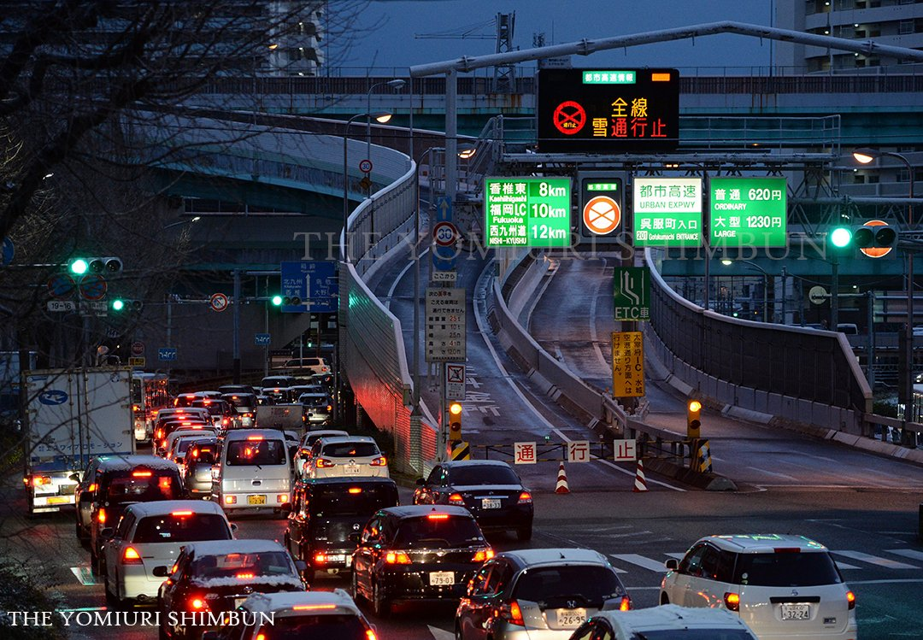
1.1
Background
Beginning
Chapter 1 - Introduction
Notes:
I‘d like to begin my topic with a photograph. We can see a quite serious traffic congestion in this slide. The express way is also blocked due to the snow. If you are blocked on the way home after work, how do you feel about this situation? Of course, I think it should not be a good experience.

Slide 5


1.1
Background
Rail transit VS Road transportation
Capacity
30,000~60,000
2000~5000
Person/h
Speed
30-50
10-15
Km/h
On time
Not sensitive to the external environment
Not on time
sensitive to the external environment
punctuality
Importance of rail transit
Meet the increasing traffic demand
Promote urban development
Chapter 1 - Introduction
Notes:
Is there any way to deal with this congestion problem?
The rail transit seems to be a good choice, since it has the features of large capacity, high speed, and punctuality. Because of these advantages, rail transit now is playing a more and more important role in the urban transportation system

Slide 6
1.1
Background
Problems in Fukuoka
1
2
Reduction in share rate of public transit
Traffic congestion
Chapter 1 - Introduction
Notes:
Let’s take a look at Fukuoka, there is also some problems in the urban transit system.
One is the reduction in the share rate of public transit. As we can see from this chart, the share rate of rail transit tends to decrease in the future, while the share rate of private car keeps on increasing. It’s not a good phenomena.

Slide 7
1.1
Background
Problems in Fukuoka
1
2
Reduction in share rate of public transit
Traffic congestion
Chapter 1 - Introduction
Notes:
Another problem is the traffic congestion that we are now facing every day. We can see from this chart the average travel speed during the crowed time in Fukuoka now is at a very low level.

Slide 8
1.2
Research purpose
Main purpose
Exploring the factors influencing rail transit ridership from multiple perspectives and estimating the influence.
Specific issues in research
1
Walking is the most important travel modes in accessing transit stations, also one of the most key determinants on the utilization of rail transit.
2
Rail transit ridership is considered to be mainly affected by the factors surrounding the station.
3
The rail transit station is in a network. When the ridership is affected by the environmental factors around the station, it is also influenced by the environmental factors around the other stations in the same network.
Chapter 1 - Introduction
Notes:
So is there anything we can do to help Fukuoka to promote the utilization of rail transit and to improve the traffic condition?
To increase the utilization of rail transit, obviously, knowing the influencing factors of transit ridership should come the first.
So, the main purpose could be, to explore the factors influencing rail transit ridership and estimate the influence.
For this purpose, there are some specific issues. The first is walking access to transit stations, second is the influencing factors of transit ridership at a single station, third is influencing factors of transit ridership at station-to-station level.

Slide 9
1.3
Summary
Reduction in share rate of public transit
Traffic congestion
Problems
Demand
Promoting the use of public rail transit
Exploring the determinants on the utilization of rail transit
Purpose
Walking duration to rail transit stations
Transit ridership at station level
Passenger flow between station and station
Subtopic
Chapter 1 - Introduction
Notes:
I will give a summary of the introduction.
Now Fukuoka is facing the problem of reduction in share rate of public transit, and traffic congestion. So, promoting the use of public rail transit seems to be a good choice for Fukuoka.
With this background and demand, the purpose of exploring the determinants on the utilization of rail transit is proposed.
Around this main purpose, the research contents are extended to 3 subtopics
walking duration to rail transit stations, Transit ridership at station level, passenger flow between station and station.

Slide 10
1.4
Organization
Chapter 1
Introduction of the dissertation including background, purpose, literature review.
Exploring the factors influencing walking duration to transit stations from the perspective of passengers’ attributes.
Chapter 2
Walking duration
Clarify the characteristics of transit ridership and land use
Chapter 3
Characteristics analysis. Preliminary research for chapter 4, 5
Chapter 4
Chapter 5
Exploring the factors influencing transit ridership at station level
Exploring the factors influencing transit ridership at station-to-station level
Transit ridership at station level
Transit ridership at station-to-station level
Chapter 6
Summarizing the findings achieved in each chapter, and giving the conclusion for this dissertation
Chapter 1 - Introduction
Notes:
This research is organized into 6 chapters. Chapter 2, 4, 5 correspond to the three subtopics, chapter 3 is a preliminary study for supporting chapter 4 and 5.

Slide 11
Chapter 2
Analyzing Willingness of Walking Duration to Transit Stations Using Socio-Demographic Characteristics
Notes:
Chapter 2, Analyzing Willingness of Walking Duration to Transit Stations Using Socio-Demographic Characteristics.

Slide 12
2.1
Introduction
distance to destinations is widely thought to be an important predictor of active travel
Background
Walking is the most important travel modes in accessing transit stations.
Walking duration to transit station is widely accepted to be an important determinants on the utilization of rail transit.
Main purpose
Exploring the factors influencing walking duration to transit stations from the perspective of passengers’ attributes.
Chapter 2 - Analyzing Willingness of Walking Duration to Transit Stations Using Socio-Demographic Characteristics
Notes:
Walking is the most important travel modes of accessing transit stations. The Walking duration to transit station is also widely thought to be an important determinants on the use of rail transit.
With this background, the purpose of this study can be proposed. That is to explore the factors influencing walking duration to transit stations from the perspective of passengers’ attributes.

Slide 13
2.1
Introduction
Review
 | Study | Type 1 | Type 2 | Type 3 | This
Research object | Walking distance | ● |  | ●
 | Walking duration |  | ● |  | ●
Method | Statistical description | ●
 | Regression |  | ● | ●
 | Nonlinear fitting |  |  |  | ●
Predictable | No | ● | ● | ●
 | Yes |  |  |  | ●
Result |  | Survey result description | Some factors were found, but prediction and verification were not given | No relationship found | Having relationship with travel purpose, travel time period, age, and occupation
Chapter 2 - Analyzing Willingness of Walking Duration to Transit Stations Using Socio-Demographic Characteristics
Notes:
Before running the analysis, let’s take a look at how this study differs from the others.
The research object in this study is the walking duration to transit stations.
As to the methods, studies based on statistical description account for the majority, while some studies tried to use regression model to find the relationship between walking duration and personal attributes, but they didn’t get an expected result.
This study uses the nonlinear fitting method to find the relationship of walking duration and personal attributes, then try to make a prediction for the walking duration.

Slide 14
2.1
Introduction
Research contents
Problems in previous studies
Key points
Problem 1
1
Function of walking duration
Most studies use qualitative methods. Few quantitative analysis obtained the significant result on estimating walking duration. The reason of that may be in the data processing, the model constructing, also model estimating.
Using probability but not the linear relationship to describe the walking duration preference of passengers with different attributes.
Chapter 2 - Analyzing Willingness of Walking Duration to Transit Stations Using Socio-Demographic Characteristics
Notes:
Ok, now let’s have a look at the research contents.
According to the review of previous studies, some existing problems are summarized. This study will focus on some key points based on these problems.
The first problem is few quantitative analyses obtained a significant result, it means they didn’t find a proper function to describe the relationship between walking duration and personal attributes.
For this problem, two key points will be addressed in this study. one, construct a proper function to describe the relationship of walking duration and the indicators. two, identify the effective indicators that indeed have influences on the preference to walking duration.

Slide 15
2.1
Introduction
Research contents
Problems in previous studies
Key points
Problem 2
2
Estimation and evaluation
Although many studies have summarized some factors affecting the walking duration through qualitative methods, none of them quantitatively verified the effect of the influencing factors.
To estimate the relationship between identified influencing factors and walking duration. Then evaluating the prediction to judge the effectiveness of identified influencing factors.
Chapter 2 - Analyzing Willingness of Walking Duration to Transit Stations Using Socio-Demographic Characteristics
Notes:
Another problem is the effect of indicators cannot be quantified. It means the result cannot be used for prediction.
So the third key point in this study is to estimate the relationship between identified influencing factors and walking duration. Then use this obtained relationship to make a prediction.

Slide 16
2.1
Introduction
Construct the indicator system
Exploratory variable
Passenger attributes
Probability of walking the given duration or more
Dependent variable
Data cleaning
Valid travel chain info
1
Key point
Identify valid feature
Variance analysis
2
Key point
Verify the extracted features
Prediction
Random forest decision tree
Result of individual
evaluation
Walking duration preference
Result of group
Conclusion
3
Key point
Chapter 2 - Analyzing Willingness of Walking Duration to Transit Stations Using Socio-Demographic Characteristics
Notes:
This is the flowchart of this study. It is organized into 6 parts. They are constructing the indicator system, cleaning data, identifying valid features, verifying the valid features, and estimating walking duration preference. The conclusion comes the last.
The key points of this studies are marked with yellow block.

Slide 17



2.2
Methods
Problem description
Give an example, for one person who has the attributes:
$\left(Male, 25 years old, student, peak hour, go to school\right)$
Realistic issue
I can accept a walking duration less than 8 minutes
OK
8 min
4 min
0 min
Reflected in survey
I walked 6 minutes to the station
6 min
0 min
Chapter 2 - Analyzing Willingness of Walking Duration to Transit Stations Using Socio-Demographic Characteristics
Notes:
Next, I will give a simple example to explain how I deal with the walking duration.
Think about a people who has the attributes like this, we suppose this passenger can accept a walking duration less than 8 minutes for accessing transit stations.
But if it is reflected in a questionnaire, the answer may be like “I walked 6 minutes to the station”. Obviously, it cannot represent how long he is willing to walk to the station. This 6 minutes is just the distance between his starting point and the station.
Here the deviation appeared. The next slide, I will continue to explain how to deal with this problem.

Slide 18




2.2
Methods
Problem description
Distance
Actual walking duration
Attributes
Willingness of walking duration
Personal socio-demographic characteristics
Other personal attributes
Trip chain info
Chapter 2 - Analyzing Willingness of Walking Duration to Transit Stations Using Socio-Demographic Characteristics
Notes:
Here is a relation map of distance, attributes, willingness, and actual walking duration.
The actual walking duration is the original data that we can obtain from the questionnaires. As shown in this relation map, the actual walking duration should be directly determined by the distance between the starting point and the station.
We assume that people with different attributes should have different willingness of walking duration, and this willingness can affect the final actual walking duration as well. But, the attributes should never affect the actual walking duration directly.
So, what I want to do is to build a bridge between the attributes and actual walking duration through the willingness.

Slide 19
2.2
Methods
Model construction
If investigating the 6-minute walking duration
I walked 3 minutes
I walked 10 minutes
Uncertainly
if 6 minutes can be accepted
Certainly
6 minutes can be accepted
Actual
walking duration
Less than
6 minutes
More than
6 minutes
Proportion
Willingness
Uncertain
Certain
With a giving actual walking duration
$$Willingness=Function\left(personal attributes\right)$$
Chapter 2 - Analyzing Willingness of Walking Duration to Transit Stations Using Socio-Demographic Characteristics
Notes:
And this is the bridge. I’d like to raise another example to explain it.
We can take the 6-minute walking duration as the investigation object, if the respondent answered that “I walked 10 minutes to the station”, it not only means this passenger walked 10 minutes, but also tells us the 6-minute walking duration is certain to be accepted by this passenger. While if someone said “I walked 3 minutes”, it means the 6-minute walking duration is uncertain to be accepted.
Well, we can get a relationship between the actual walking duration and the willingness.
And obviously, the willingness of walking duration can be expressed as the function of personal attributes.
Here the bridge between personal attributes and the actual walking duration can be established.

Slide 20
2.3
Data
Indicators
Dependent variable
Probability
Walk longer than the given threshold of walking duration
Explanatory variables
Attributes
Personal socio-demographic characteristics
Other personal attributes
Trip chain info
Chapter 2 - Analyzing Willingness of Walking Duration to Transit Stations Using Socio-Demographic Characteristics
Notes:
Then I will give a brief introduction for the indicators used in this study.
The definition of the dependent variable is the key point to bridge the actual walking duration and the personal attributes. Just as I interpreted in the last slide, here the dependent variable is defined as the probability of walking longer than the given threshold of walking duration.
The explanatory variables are passengers’ attributes including socio-demographic characteristics, some other personal attributes, and the trip chain information.

Slide 21
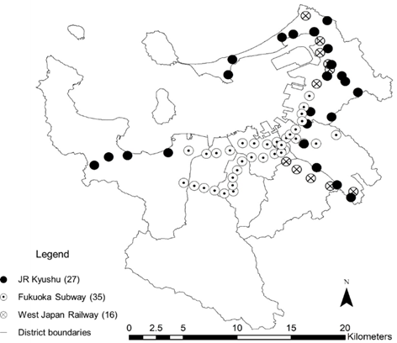
2.3
Data
Study case: Fukuoka
Distribution of the transit stations
Data in this study
Chapter 2 - Analyzing Willingness of Walking Duration to Transit Stations Using Socio-Demographic Characteristics
Notes:
The study case and data source.
This study uses the rail transit stations of Fukuoka, including 78 stations in total.
The main data source is the person trip survey, it mainly includes the information about trip chaining behavior and some socio-demographic attributes.

Slide 22
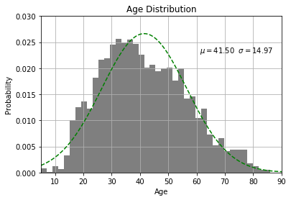
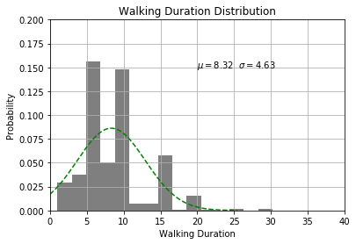
2.3
Data
Distribution characteristics
Peak values at 5, 10, 15 min
The age distribution of passengers
Distribution of walking duration
The passengers aged between 25-55 who are still at production age account for the majority
People tend to reply a looser answer when they are being asked some questions about details.
Chapter 2 - Analyzing Willingness of Walking Duration to Transit Stations Using Socio-Demographic Characteristics
Notes:
A brief description for the data. The left part is the age distribution of passengers.
As we can see in this figure, the passengers aged between 25-55 who are still at production age account for the majority. The right part is the distribution of walking duration, we can clearly see 3 peak values in this figure, they are 5, 10, 15 minutes.
Here I want to have a try to give some explanations to it. It can be easily imagined that if people were asked some questions about details like how much did you spend, how long did you take, for such kinds of questions, people tend to reply a looser answer, some general numbers like 5, 10, or something. Maybe this is the reason that the peak values appeared at 5, 10, 15 minutes.
These peak values may be one of the reasons that the previous studies didn't get the expected result. But these peak values are considered not to lead deviation in this study. Because the walking duration that passengers answered in the questionnaires represents this walking duration has already been accepted by the passengers, even it is not accurate.

Slide 23
2.4
Selection of valid features
Selection of thresholds
According to the distribution of walking duration in Fukuoka, the acceptable walking duration mainly range from 5 – 13 minutes.
In this study, the average walking duration is about 8 minutes.
The thresholds selected in this study is 5, 8, 13 minutes.
Identification of valid features (analysis of variance)
5 minutes
8 minutes
13 minutes
Age over 65
Peak hour
No occupation
purpose of work
purpose of business
purpose of entertainment
purpose of going home
Female
Age from 25 to 44
Peak hour
Purpose of work
Purpose of business
Purpose of entertainment
Purpose of going home
Age from 45-64
Peak hour
purpose of work
purpose of entertainment
Chapter 2 - Analyzing Willingness of Walking Duration to Transit Stations Using Socio-Demographic Characteristics
Notes:
For the threshold of walking duration we are going to investigate, according to the distribution of walking duration in Fukuoka, the 5, 8, 13 minutes are selected as the threshold to be investigated.
Then I use the analysis of variance to extract the valid features at each threshold of walking duration. We can see that the features vary from different walking duration.

Slide 24
2.5
Prediction and evaluation
Decision tree and random forest
Reason for choosing decision tree
Used as an exploratory method for the dataset with unknown feature distribution
Reason for adding forest random
Reduce the possibility of over-fitting of data which is easily occurred in the decision tree model.
Flow
Input
50% training set
50% testing set
Train the model
Get the rule
Verify the model
Chapter 2 - Analyzing Willingness of Walking Duration to Transit Stations Using Socio-Demographic Characteristics
Notes:
Now we have got the valid features, the next step is to estimate the model to find the relationship between walking duration and the indicators.
With the consideration of the dataset and the research purpose, the random forest decision tree model is introduced to this study.
The procedure has two steps, training the model, and verifying the model. The dataset is split into the training set and testing set, for 50 percent respectively.

Slide 25
2.6
Prediction and evaluation
Predictive power of individual
Object: Individual
Index: Kappa indicator
Range
-1
1
Worse
Predictive power
Better
Predictive power of group trends
Object: Group of 200 individuals
Index: Coefficient of determination
Range
……
0
1
Worse
Predictive power
Better
Chapter 2 - Analyzing Willingness of Walking Duration to Transit Stations Using Socio-Demographic Characteristics
Notes:
The prediction is evaluated from two ways, for the individual and group.
The predictive power of individual is evaluated by the Kappa index. This index ranges from minus one to one, the higher value means a better predictive power.
The predictive power of group is evaluated by the coefficient of determination, it ranges from 0 to 1. Higher value represent a better predictive power.

Slide 26
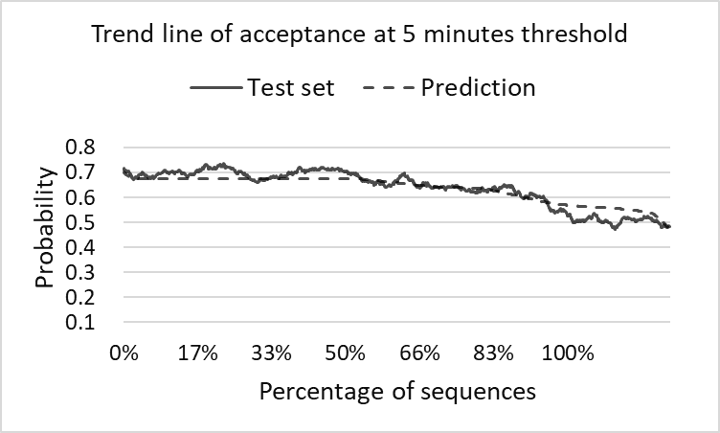
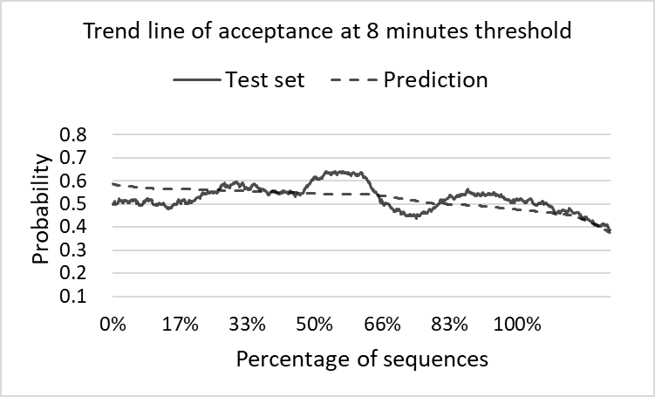
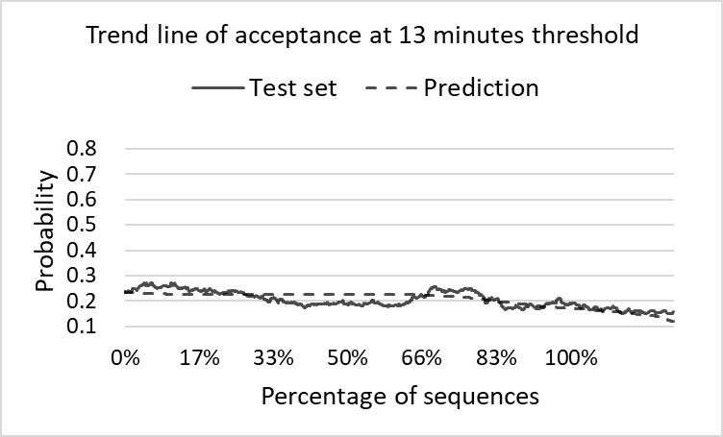
2.6
Prediction and evaluation
5 minutes
8 minutes
13 minutes
Predictive power of individual
Kappa index
0.142
0.016
0.060
Predictive power of group trends
Coefficient of determination
0.843
0.221
0.426
Chapter 2 - Analyzing Willingness of Walking Duration to Transit Stations Using Socio-Demographic Characteristics
Notes:
Let’s take a look at the result.
We can see that the result of 5-minute walking duration is better than the other two walking duration.
The results at 8-minute are less accurate.

Slide 27
2.7
Conclusion
Findings
Prediction
Walk more
Walk less
5 minutes threshold
Business purpose
Private purpose
Going home purpose
Older than 65
No occupation
Individual: 0.142
Peak hour
Commuting to work
Group trend: 0.843
8 minutes threshold
Age between 25-44
Female
Peak hour
Commuting to work
Business purpose
Private purpose
Going home purpose
Individual: 0.016
Group trend: 0.221
13 minutes threshold
Age between 45-64
Peak hour
Commuting to work
Private purpose
Individual: 0.060
Group trend: 0.426
Chapter 2 - Analyzing Willingness of Walking Duration to Transit Stations Using Socio-Demographic Characteristics
Notes:
I will give a summary of the results.
In this table, the left column is the predictive power, the right part is the personal attributes identified at each threshold of walking duration. The column of walk more means passengers with these attributes tend to walk longer than the given walking duration, the attributes in the column of walk less means passengers tend to walk less than the given walking duration.
Passengers with the private travel purpose tend to accept the longest walking duration. Passengers with the commuting travel purpose and during the peak hour tend to arrive at transit station as soon as possible.
Something also can be inferred from this result. The 5 minutes walking duration can be widely accepted, some passengers who cannot accept this walking duration should have some significant characteristics, so this 5-minute walking duration has a higher predictive power. The 8 minute walking duration is a little ambiguous in passenger’s behaviors, therefore it is a little difficult to predict.

Slide 28
2.7
Conclusion
Summary
Problems
Achievements
1
Little quantitative relationship between walking duration and passengers’ attributes was found.
Describe passengers' walking duration preferences using the probability of walking longer than a given threshold.
2
Few of the existing studies quantitative verified the effect of influencing factors
The effect of influencing factors is predicted, the results are evaluated from the view of both individual and group.
Chapter 2 - Analyzing Willingness of Walking Duration to Transit Stations Using Socio-Demographic Characteristics
Notes:
To the summary, the main achievements of this study:
1. This study described passengers' walking duration preferences using the probability of walking longer than a given threshold.
2. The effect of influencing factors is predicted, the results are evaluated from the view of both individual and group.

Slide 29
Chapter 3
Analysis on the Characteristics of Transit Ridership and Land Use
Notes:
This is the chapter 2. Next, chapter 3, Analysis on the Characteristics of Transit Ridership and Land Use

Slide 30
3.1
Introduction
Research position
Preliminary study
Ridership Estimation
Characteristics
Station level
Chapter 4
Land use
Ridership
Station-to-station
Chapter 5
Relationship
Chapter 3
Purpose
To grasp the characteristics of transit stations in terms of both transit ridership and land use in Fukuoka.
Chapter 3 - Analysis on the characteristics of transit ridership and land use
Notes:
This chapter is a preliminary study for estimating the influence of transit ridership, it mainly focus on the characteristics of transit ridership and land use, also give a simple exploration on the relationship between them.
The purposes of chapter 3 is to grasp the characteristics in terms of both transit ridership and land use.

Slide 31
3.1
Introduction
Problems
Key points
1
Characteristics of transit ridership
Summary the characteristics of rail transit ridership in spatial and temporal distribution
Problem 1
The characteristics of rail transit ridership and land use in Fukuoka needs to be clarified.
2
Characteristics of land use
Analyze the characteristics of land use around the subway in terms of the type of land use
3
Relationship between rail transit ridership and land use
Preliminary explore the relationship between rail transit ridership and land use
Chapter 3 - Analysis on the characteristics of transit ridership and land use
Notes:
To make a detailed understanding of the rail transit system in Fukuoka, this chapter mainly focused on three key points. 1. to summarize the characteristics of rail transit ridership. 2. To analyze the characteristics of land use around the subway stations. 3. To make a preliminary exploration on the relationship between rail transit ridership and land use.

Slide 32
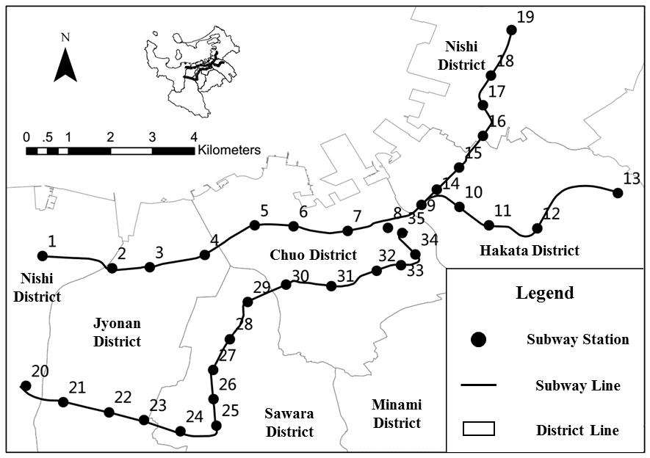
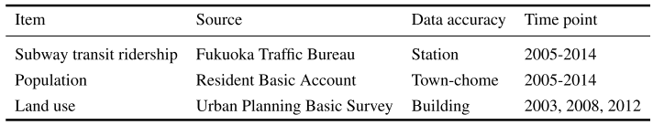
3.2
Data
Study case
Fukuoka subway
35 subway stations
3 operating subway lines
29.8 km operating mileage
20% share of motorized travel
Data source
Chapter 3 - Analysis on the characteristics of transit ridership and land use
Notes:
This is the overview of study case and data source.
The study case is Fukuoka subway station.
The main data source in this study is the subway transit ridership, the statistics of population and land use.

Slide 33
3.3
Characteristics of transit ridership and land use
Transit ridership characteristics
Trends of variation in transit ridership
Growth trend.
More than 600,000 passengers per day.
Significant difference in ridership among the three lines.
Chapter 3 - Analysis on the characteristics of transit ridership and land use
Notes:
This is the trends of variation in transit ridership.
The ridership keeps a growth trend. Currently, the subway system carries 6 hundred thousands passengers per day.
And the three lines showed significant difference in ridership.

Slide 34
3.3
Characteristics of transit ridership and land use
Transit ridership characteristics
Annual growth rate of transit ridership
Line 3 had a much higher growth rate at the first few years of the opening
The growth rate of three lines tend to be stable after the year of 2009
Chapter 3 - Analysis on the characteristics of transit ridership and land use
Notes:
The annual growth rate of transit ridership.
We can see from the figure that line 3 had a much higher growth rate at the first few years of the new opening.
The growth rate of three lines tend to be stable after the year of 2009.

Slide 35
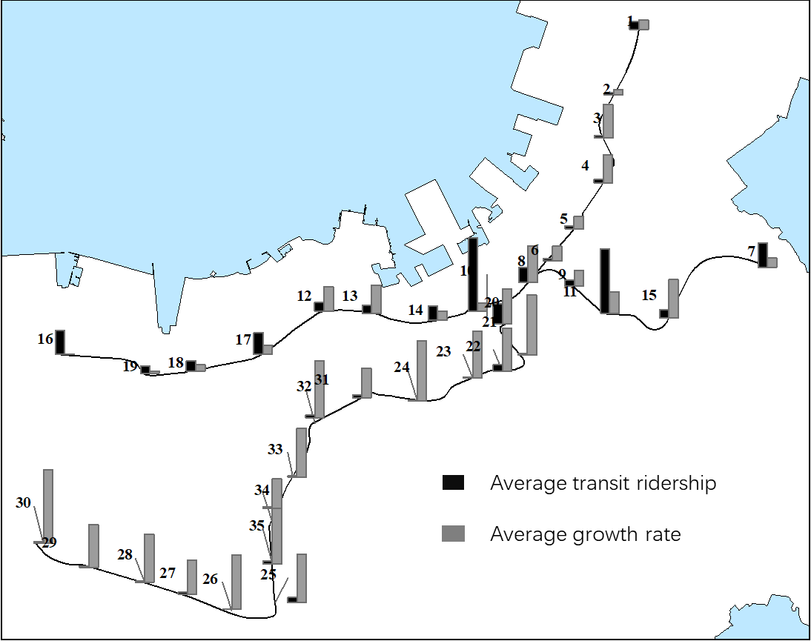
3.3
Characteristics of transit ridership and land use
Transit ridership characteristics
Spatial distribution of transit ridership
Terminal
Airport
Hub
Hub
Terminal
Newly opened
Chapter 3 - Analysis on the characteristics of transit ridership and land use
Notes:
This is the spatial distribution of transit ridership.
Fukuoka subway has two terminal stations, two hub stations, and one station serving for the airport.
We can see that, most stations located in the central area have larger transit ridership.

Slide 36
3.3
Characteristics of transit ridership and land use
Transit ridership characteristics
Classification based on transit ridership
Transit ridership | Total | Line 1 | Line 2 | Line 3
Hub | 2 | 2 | 0 | 0
Large | 4 | 3 | 0 | 1
Medium | 11 | 8 | 1 | 2
Small | 18 | 0 | 4 | 4
Line 1
Large scale
Low growth rate
Line 2
Small scale
Low growth rate
Growth rate | Total | Line 1 | Line 2 | Line 3
0-2.5 | 12 | 8 | 4 | 0
2.5-4.5 | 11 | 5 | 2 | 4
4.5-6.0 | 6 | 0 | 0 | 6
6.0- | 6 | 0 | 0 | 6
Line 3
Small scale
High growth rate
Chapter 3 - Analysis on the characteristics of transit ridership and land use
Notes:
Two cross tables about the transit ridership and the growth rate are given to help to understand the characteristics.
Both line 1 and line 2 have low growth rates, line 1 has a larger transit ridership. For line 3, although the scale of transit ridership is still small, it keeps on a high growth rate.

Slide 37
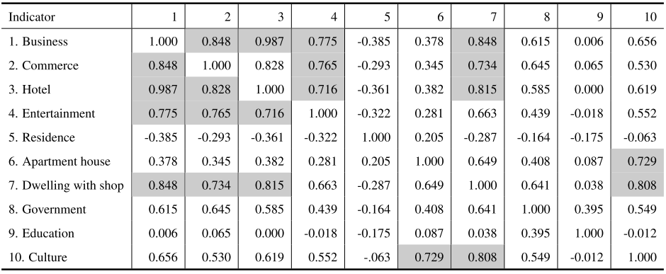
3.3
Characteristics of transit ridership and land use
Land use characteristics
Correlation analysis for indicators
High correlation ( >0.7)
Chapter 3 - Analysis on the characteristics of transit ridership and land use
Notes:
Because there are so many types of land use, we need to master the relationship among all the kinds of land use at first.
This table is the result of correlation analysis, the cells marked with grey color means there is a strong linear correlation between the two indicators.

Slide 38
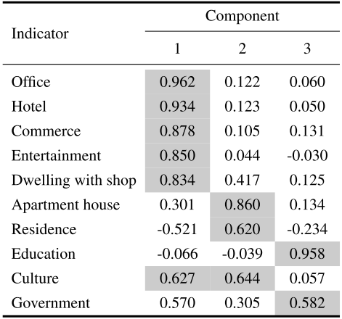
3.3
Characteristics of transit ridership and land use
Land use characteristics
Factor extraction
Factor 1: Ofﬁce & commerce
Component Matrix
Office
Hotel
Commerce
Entertainment
Dwelling with shop
Culture
Factor 2: Residence
Apartment house
Residence
Culture
Factor 3: Education
Education
Government
Chapter 3 - Analysis on the characteristics of transit ridership and land use
Notes:
To deal with this linear correlation, the factor analysis is conducted to make a in-depth exploration on the internal relationship.
As a result, three factors are extracted, they are office & commerce, Residence, and education.

Slide 39
3.4
Characteristics of transit ridership and land use
Land use characteristics
Station classification based on land use
114
74
Population Density
Person/Ha
62
151
99
Chapter 3 - Analysis on the characteristics of transit ridership and land use
Notes:
According to the analysis of land use indicators, all the 35 stations are classified into several types.
They are office type, downtown commerce type, education type, high-density residence type, and low-density residence type.
This is the summary for each type of stations.

Slide 40
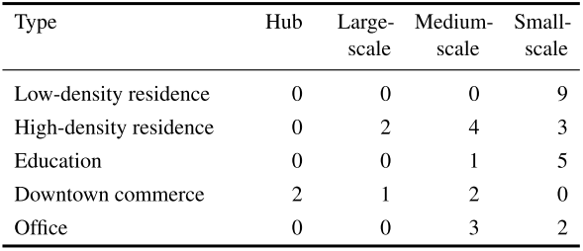
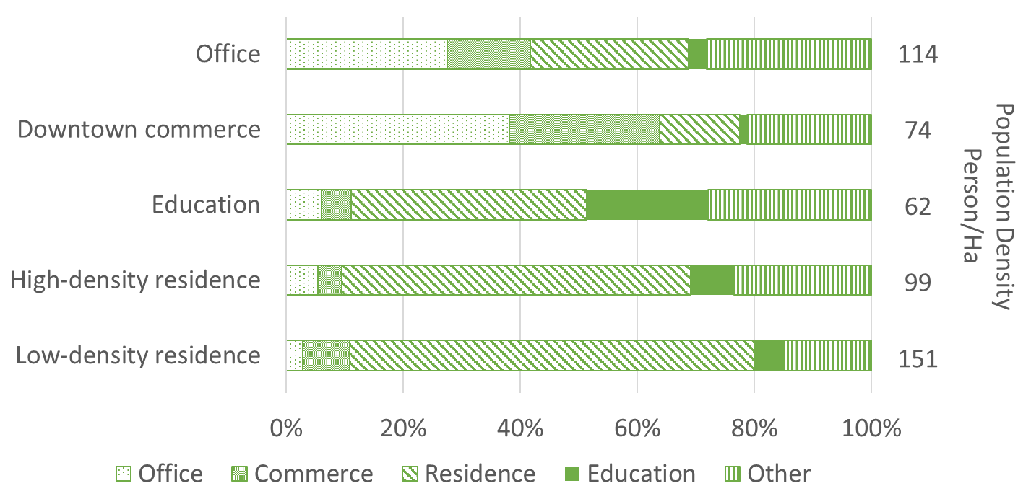

3.4
Exploration the influence on transit ridership
General relationship
Transit ridership
Land use
Characteristics
Large differences in different types
Low density = Low ridership
Commercial center = High ridership
Chapter 3 - Analysis on the characteristics of transit ridership and land use
Notes:
Combining with the cross table of land use and transit ridership, we can get some information.
That is, different land use characteristics have different scales in transit ridership.
The density of both population and land use have significant influence on transit ridership.
Commercial land use produces more ridership than other land use types

Slide 41
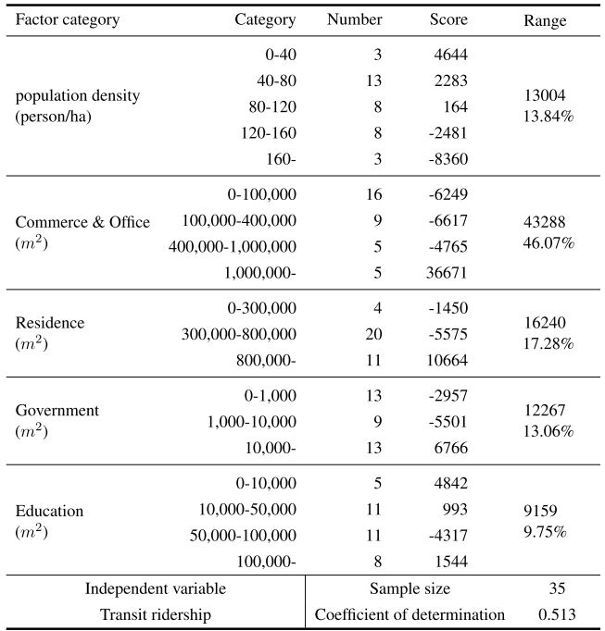
3.4
Exploration the influence on transit ridership
Statistical relationship - quantiﬁcation method I
Part 1
Dependent variable
Transit ridership per day
Explanatory variables
Population density
Commerce & office
Residence
Education
Coefficient of determination
0.513
Key factors
Commerce area
Office area
Chapter 3 - Analysis on the characteristics of transit ridership and land use
Notes:
After a general understanding of the relationship between ridership and land use, the quantification method one is used to make a deeper exploration.
In the first part of quantification method one, the dependent variable is transit ridership per day.
But the estimation did not show a good fitness

Slide 42
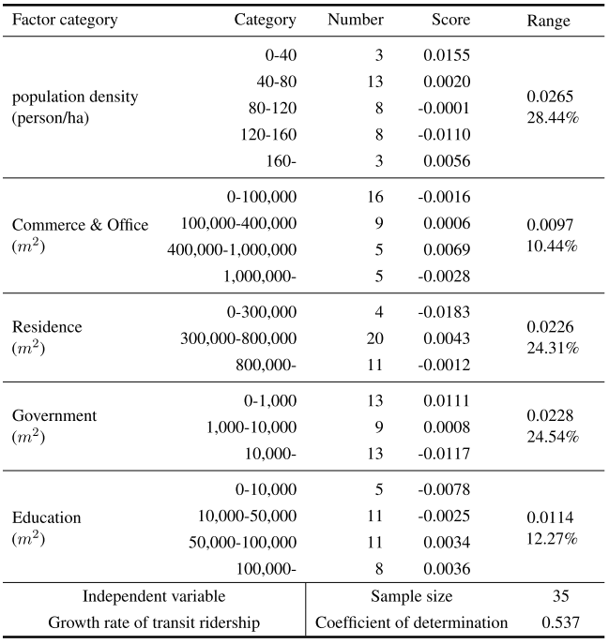
3.4
Exploration the influence on transit ridership
Statistical relationship - quantiﬁcation method I
Part 2
Dependent variable
Growth rate of transit ridership
Explanatory variables
Population density
Commerce & office
Residence
Government
Education
Coefficient of determination
0.537
Key factors
Population density
Chapter 3 - Analysis on the characteristics of transit ridership and land use
Notes:
In part 2, the same indicators are used for estimating the growth rate of transit ridership.
The same with part 1, the result did not show a good fitness as well.

Slide 43
3.5
Conclusion
Summary
Through the summary and analysis, we got a comprehensive understanding of rail transit utilization and land use status in the case of Fukuoka City.
Provided foundation and references for the further exploration on the determinants on transit ridership
Implications
Pedestrian area should be considered.
Explanatory variables should be enriched.
Model should be improved.
The approach of dealing with small sample case should be considered.
Chapter 3 - Analysis on the characteristics of transit ridership and land use
Notes:
This is the contents of chapter 3.
Through this study, we got a comprehensive understanding of transit ridership and land use status in the case of Fukuoka City.
This study also provided the foundation and references for the next exploration of the determinants on transit ridership
Some implications can be got from this chapter.
1. Pedestrian area should be considered in depicting the catchment area.
2. Explanatory variables should be enriched.
3. The Model should be improved.
4. The approach of dealing with small sample case should be considered.

Slide 44
Chapter 4
Influencing Factors on Transit Ridership at Station Level
Notes:
On the base of chapter 3, chapter 4 aims to make a deeper exploration on factors influencing subway ridership at station level.

Slide 45
4.1
Introduction
Background
Rail transit ridership is considered to be mainly affected by the environmental factors surrounding the station.
The influencing factors are different in cities with different urban form and travel preference. Few studies focus on such a city like Fukuoka with only tens rail transit stations.
Main purpose
Explore and explain the factors influencing subway ridership at station level using a small sample case
Chapter 4 - Influencing Factors on Transit Ridership at Station Level
Notes:
As we know, rail transit ridership is considered to be mainly affected by the environmental factors surrounding the station.
The influencing factors are different in cities with different urban form and travel preference. There is a problem in the existing studies that few studies focus on such a city like Fukuoka with only tens stations.
So, the purpose of this study is to explore the factors influencing subway ridership at station level using a small sample case

Slide 46
4.1
Introduction
Review
Study type |  | Type 1 | Type 2 | Type 3 | This
Sample size | Tens |  |  |  | ●
 | Hundreds | ● | ● | ●
Method | Linear regression | ● | ● | ●
 | Spatial regression |  |  |  | ●
Catchment area | Circle buffer | ● | ●
 | Walking distance |  |  | ● | ●
Indicators | Land use |  | ● | ● | ●
 | Transit-relation | ● | ● | ● | ●
 | Demographic-relation | ● |  |  | ●
Chapter 4 - Influencing Factors on Transit Ridership at Station Level
Notes:
At first, let’s take a look at how this study differs from the others. The biggest difference in this study is the sample size. Few studies deal with a case just having tens of the samples. Because this kind of studies is commonly based on statistics, a sufficient sample size is necessary.
Moreover, with the consideration of the spatial distribution of stations, the spatial regression will be introduced to this study. Also, to define the catchment area more accurately, the walking distance along the real road network is used to determine the catchment area.

Slide 47
4.1
Introduction
Research contents
Problems in previous studies
Key points
Problem 1
1
Improve index system
Index system need to be enriched
Propose and reconstruct indicators to improve the index system
Problem 2
2
Identify valid indicators
Few studies work on the selection of valid indicators using small sample case.
Propose effective index screening method for small samples
Problem 3
3
Improve accuracy in estimation
The consideration of spatial correlation among the explanatory variables is inadequate.
Consider the different spatial distribution of indicators in the spatial regression model by identifying global/local variables.
Chapter 4 - Influencing Factors on Transit Ridership at Station Level
Notes:
According to the review, this study will focus on three points to deal with the problems existing in the previous studies.
1. Reconstruct indicators to improve the index system.
2. Select the effective indicators for explaining transit ridership in a small sample case.
3. Identify the global/local indicators in the estimation of the spatial regression.

Slide 48
4.1
Introduction
Construct the indicator system
Dependent variable
Explanatory variables
1
Key point
800m pedestrian area
Determine the catchment area
Extract indicator from the catchment area
Select valid indicators
Select valid indicators on explaining ridership
Select optimal combination of valid indicators
2
Key point
Determine local/global variables in MGWR
Key point
MGWR
3
Estimate MGWR
Conclusion
Residual analysis
Chapter 4 - Influencing Factors on Transit Ridership at Station Level
Notes:
This is the organization of this study.
It is constructed by 5 parts, constructing the indicator system, determining the catchment area, selecting the valid indicators, estimating the model, and drawing the conclusion.
The parts marked with yellow blocks are the key points in this study.

Slide 49
4.2
Indicators
Variable summary
Category | Variable | Expected sign | Min Value | Max Value | Average | Unit
Built environment | Commerce | + | 2,921 | 811,281 | 114,353 | m²
 | Office | + | 2,614 | 839,956 | 167,088 | m²
 | Residence | + | 110,748 | 1,067,523 | 528,533 | m²
 | Education | + | 294 | 305,559 | 59,691 | m²
 | Government | + | - | 128,471 | 20,878 | m²
 | Transportation Facility Area | + | 197 | 132,777 | 21,204 | m²
 | Land use Aggregation | + | 0.09 | 0.75 | 0.31 | -
Transportation Accessibility | Transfer Dummy | + | 1 | 4 | 1.34 | -
 | Bicycle Parking | Unknown | 64 | 4,375 | 778 | -
 | Bus Capacity | Unknown | 3 | 260 | 58.48 | -
 | Bus Accessibility | Unknown | 4 | 455 | 89.71 | -
 | Road Density | - | 191 | 479 | 299 | m/ha²
Demographic and Socioeconomic Environment | Population | + | 1,908 | 19,393 | 9,813 | -
 | House Member | - | 1.86 | 2.79 | 2.18 | -
 | Population/Job Balance | Unknown | 1.27 | 2.61 | 1.80 | -
 | Tenant Proportion | - | 0.15 | 0.65 | 0.43 | %
Dependent variable: average daily subway ridership
Chapter 4 - Influencing Factors on Transit Ridership at Station Level
Notes:
The introduction of the indicator system.
In this study, the dependent variable is the average daily transit ridership.
The candidate independent variables are summarized into 3 categories: 1. built environment; 2. transportation accessibility; 3. demographic and socioeconomic environment.

Slide 50

4.2
Indicators
Variable interpretation
Land-use Aggregation
Speculation of impact
Range
0
1
Higher variety
Lower variety
Much daily activity can be finished within the catchment area
Have to go further places to complete some daily activities
Reduce
travel demand
Raise
travel demand
Chapter 4 - Influencing Factors on Transit Ridership at Station Level
Notes:
Then I will introduce some of the indicators in details.
First one is the indicator of land-use aggregation.
This indicator is used to describe the variety of land use.
The land use aggregation ranges from 0 to 1. A higher variety of land use infers much daily activity can be finished within the catchment area, it is supposed to lead a reduction in transit ridership. On the contrary, a lower variety of land use is thought to raise the transit ridership

Slide 51
4.2
Indicators
Variable interpretation
Indicators of bus system
Speculation of impact
Bus system has both positive and negative effect on rail transit ridership
Share ridership from rail transit
VS
Bring ridership to rail transit
Bus capacity
Share passengers from rail transit. Negative effect on rail transit ridership
Bus Accessibility
Bring passengers to rail transit. Positive effect on rail transit ridership
Chapter 4 - Influencing Factors on Transit Ridership at Station Level
Notes:
Another one is about the bus system.
In this study, the indicator of bus system is considered from two aspects.
As shown in the figure, bus is supposed to have double effects on the rail transit, one is sharing passengers from rail transit, another one is bringing passengers to rail transit.
The indicator of bus capacity represent the ability of sharing passengers from rail transit, which is supposed to have negative effect on rail transit ridership.
The indicator of bus accessibility represent the ability of bringing passengers to rail transit, which is supposed to have positive effect on the rail transit ridership.

Slide 52

4.3
Catchment area
Walking distance
In general
Catchment area: walking distance accessing the subway station. (Pedestrian Catchment Area, PCA)
Pedestrian area range: 400m ~ 1000m
Most adopted: 800m
In the case of Fukuoka
Walking speed: about 4.8km/h
Average walking distance: about 600m
85% of passengers walk to stations
Use 800m pedestrian area as the catchment area of rail transit.
Chapter 4 - Influencing Factors on Transit Ridership at Station Level
Notes:
As to the catchment area, according to the previous studies, and the subway survey report of Fukuoka, this study uses the 800 meters real walking distance.

Slide 53
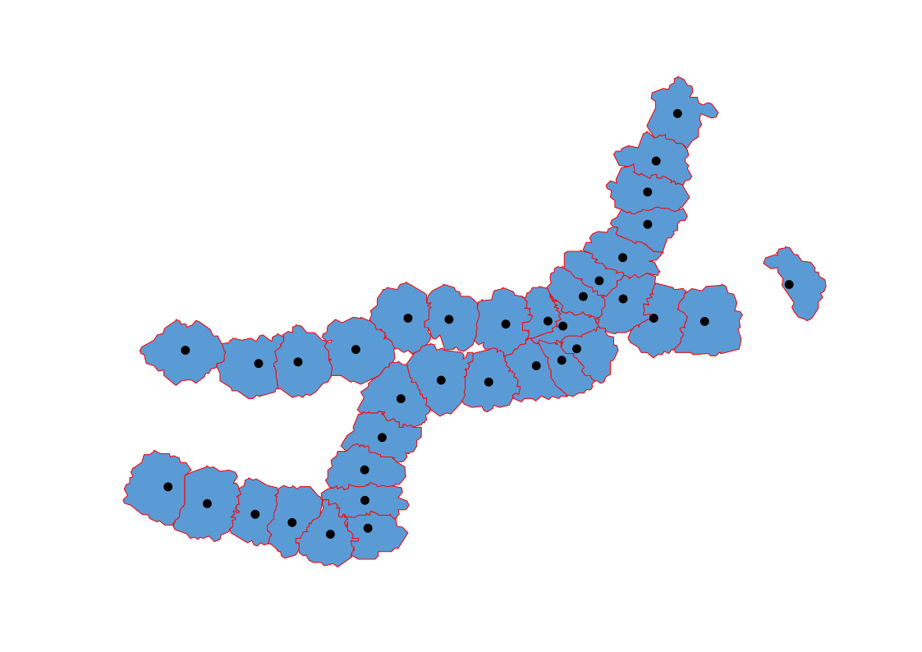
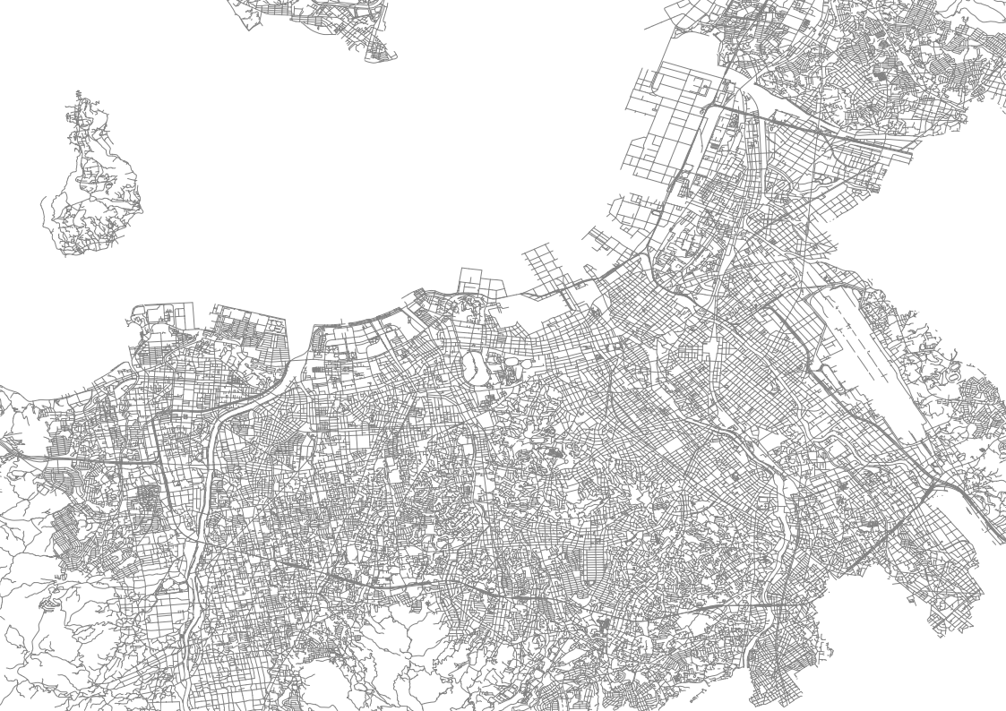
4.3
Catchment area
Separated along the river
The walking distances along the real road network are equal from any point on the boundary line to both the station on both sides.
Chapter 4 - Influencing Factors on Transit Ridership at Station Level
Notes:
The catchment area is depicted as shown in this figure.
Any point on the boundary between two stations has the equivalent distance to both the stations.
Here, there is a river between the two stations that the river separated the road network. As a result, the two catchment areas are split along this river.

Slide 54
4.4
Identification of valid factors
Flowchart of screening valid factors with small sample
Number of
indicators
Flow
16
Candidate indicators
Judgement
Multicollinearity
Validity
Stability
10
Valid indicators
9
Optimal combination
Test indicators for linear regression
Model estimation
Chapter 4 - Influencing Factors on Transit Ridership at Station Level
Notes:
This part is identifying the valid factors in the small sample case.
This is the flowchart of screening valid factors. The identification is conducted by two steps.
The first step is to identify the valid variables, using the judgement of multicollinearity, validity, and stability.
In the second step, the linear regression is conducted to select an optimal combination of valid explanatory variables.

Slide 55
4.5
Model estimation
Identification for global/local variable
Variable | Moran's Index | P-value*
Government Area | 0.04 | 0.51
Transportation Facility | 0.29 | 0.00
Land use Aggregation | -0.01 | 0.84
Transfer Dummy | 0.13 | 0.12
Bicycle Parking | -0.12 | 0.36
Bus Capacity | 0.70 | 0.00
Bus Accessibility | 0.45 | 0.00
Population/Job Balance | 0.77 | 0.00
Tenant Proportion | 0.24 | 0.01
P > 0.05
Pattern | Type
Random | Global
Clustered | Local
Random | Global
Random | Global
Random | Global
Clustered | Local
Clustered | Local
Clustered | Local
Clustered | Local
Pattern: Random
Type: Global
P ≤ 0.05
Pattern: Clustered
Type: Local
Chapter 4 - Influencing Factors on Transit Ridership at Station Level
Notes:
Now we have got the valid explanatory variables.
Before estimating the model, we should determine whether the indicator is a local or global indicator.
This procedure is conducted by using Moran’s index to examine if the variable is spatial autocorrelation or not.
As the result, the indicators of clustered pattern are selected as the local variable, while the random pattern are judged as the global variable.

Slide 56
4.5
Model estimation
Estimation of Mix Geographically Weighted Regression
Variable | Unit | Type |  | MGWR model
 |  |  |  | B | t
Government Area | m² | Global |  | 0.05 | 2.59
Land Use Aggregation | coef (0-1) | Global |  | 13,384.34 | 2.48
Transfer Dummy | dummy | Global |  | 5,968.65 | 4.98
Bicycle Parking | count | Global |  | 7.72 | 8.59
Transport Area | m² | Local |  | 0.10 | -
Bus Capacity | coef | Local |  | -55.14 | -
Bus Accessibility | coef | Local |  | 48.61 | -
Population/Job Balance | coef | Local |  | -2,411.17 | -
Tenant Proportion | % | Local |  | -10,304.66 | -
Chapter 4 - Influencing Factors on Transit Ridership at Station Level
Notes:
This is the result of estimation.
As a result, the indicators of building area have a positive effect on the transit ridership.
The indicator of land-use aggregation shows land use variety can lead to decrease in transit ridership.
As the expectation, the indicator of bus capacity has a negative effect on the subway ridership, and the bus accessibility has a positive effect.
The factor of resident/job balance and tenant proportion tells that working people and tenants are more willing to use subway.

Slide 57
4.6
Conclusion
Summary
Summary
Achievements
Problems
1
Indicator system need to be enriched
Reorganized the indicator system. Proposed the indicators of land use variety, bus capacity and bus accessibility.
To reduce the first and second type of statistical error in small sample case, use exploratory regression to screen effective indicators and the most metric combinations.
2
Selection of effective indicators under small sample
3
Insufficient consideration of spatial relevance of indicators
Identified global/local indicator in MGWR using the spatial autocorrelation of indicators.
Chapter 4 - Influencing Factors on Transit Ridership at Station Level
Notes:
The main achievements of this study can be summarized as following
This study reorganized the indicator system.
To reduce the first and second type of statistical error in small samples case, this study used exploratory regression to screen effective indicators.
Identified global/local indicator in Mix Geographically Weighted Regression.

Slide 58
Chapter 5
Impact of Land Use Types on Transit Ridership between Stations and Stations
Notes:
Chapter 5, Impact of Land Use Types on Transit Ridership between Stations and Stations

Slide 59
5.1
Introduction
Background
The rail transit station is in a network. When the ridership is affected by the environmental factors around the station, it is also influenced by the environmental factors around the other stations in the same network.
Land use determines travel purpose in some extent. The variation in the land use of departure station can affect the choice of travel destination.
Main purpose
Explore the impact of land use on the choice of destination station.
Chapter 5 - Influencing Factors on Transit Ridership at Station-to-Station Level
Notes:
We know that the rail transit stations are in a network. The transit ridership is not only affected by the elements around the station, but also be affected by the other stations in the same network.
On the other hand, because land use is one of the most important determinants on travel purpose. The variation in the land use of departure station is considered to have influence on the choice of travel destination.
Therefore, the main purpose of this study I to explore the impact of land use on the choice of destination station.

Slide 60
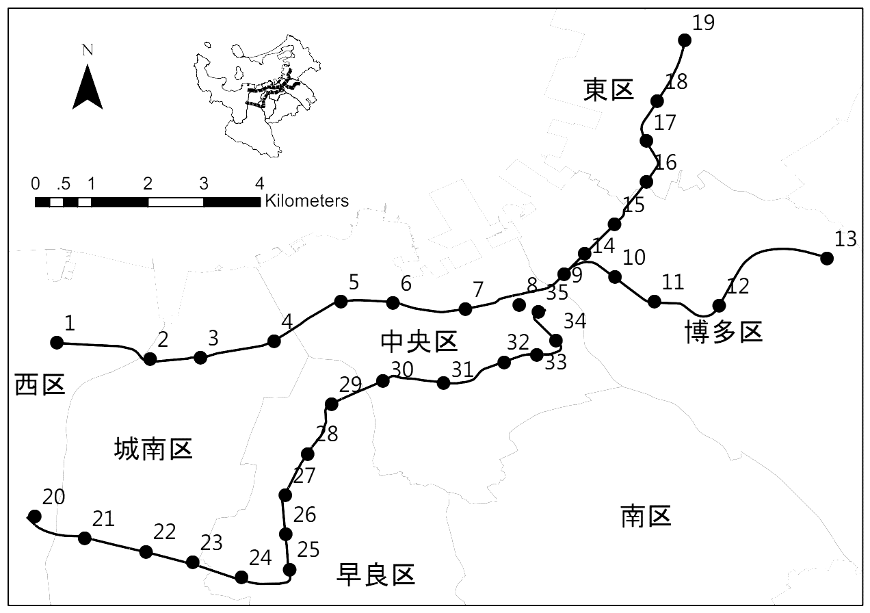
5.1
Introduction
Background
The increased ridership will be transferred to the other stations
Downtown area
Office gathering area
Question: How the land use type of a station influence the choice of destination?
Chapter 5 - Influencing Factors on Transit Ridership at Station-to-Station Level
Notes:
I’d like to give a brief introduction for what I want to do in this study.
As shown in this slide, if the transit ridership increased in this station, the increased part will be transferred to the other stations in the network, Due to different travel purpose, this part of increased passengers will choose different stations as the destinations.

Slide 61
5.1
Introduction
Review
Differences with station-level
 | Type 1 | Type 2 | This
Scale | Station-level | Station-to-station level | Station-to-station level
Research object | Transit ridership of a single station | Transit ridership between station and station | Probability of choosing the a specific station as the destination
Functional relationship | Linear relationship | Linear relationship | Probability relationship (Binary choice)
Chapter 5 - Influencing Factors on Transit Ridership at Station-to-Station Level
Notes:
Then I will give a brief review to make clear the differences from previous studies.
For the research object, differ from station-level, the research object is not the passenger volume of a single station but the passenger flow between station and station.
Although some studies have paid attention to the station-to-station level, they just simply changed the research object to the passenger flow between station and station, but the functional relationship they examined is still the linear relationship.
This study uses the probability of choosing a specific station as the destination to describe the passenger flow between station and station.

Slide 62
5.1
Introduction
Research contents
Problems in previous studies
Key points
Problem 1
1
Describe the passenger flow between station and station using the probability of choosing a specific station as the destination.
How to describe and define the passenger flow between station and station?
2
Convert the problem of passenger flow to a binary choice problem, then estimate the influence of land use on the choice of destination.
Problem 2
How to establish the functional relationship between the passenger flow and land use?
Chapter 5 - Influencing Factors on Transit Ridership at Station-to-Station Level
Notes:
According to the review, this study will focus on 2 points to deal with the problems existing in the previous studies.
For the problem of how to describe and define the passenger flow between station and station? This studies describes it using the probability of choosing a specific station as the destination
For the second problem of how to establish the functional relationship between the passenger flow and land use? This study converts this issue to a binary choice problem, then use logistic regression to estimate the influence of land use on the choice of destination.

Slide 63
5.1
Introduction
Flowchart
1
Key point
Probability of getting off at a specific destination station
Research object
Dependent variable
Land use
Indicator system
Independent variable
impedance
Convert into a binary choice problem
Model construction
2
Key point
Model estimation
Logistic regression
Conclusion
Chapter 5 - Influencing Factors on Transit Ridership at Station-to-Station Level
Notes:
This is the general flow of this study. It contains 5 main parts. Defining the research object. Establishing the indicator system. Building the model, then estimating the model. Finally drawing the conclusion. The key points of this study is marked with yellow blocks.

Slide 64
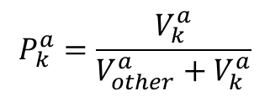
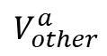
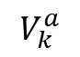
5.2
Research object
Dependent variable
Probability of choosing the destination
Destination
Station
If Investigating the relationship between station a and station k
Other
Stations
Passenger Volume
b
c
$$V_{other}^{a}$$
d
e
……
Boarding
Station
a
Station k
Passenger Volume
k
$$V_{k}^{a}$$
Expression
$$P_{k}^{a}=\frac{V_{k}^{a}}{V_{other}^{a}+V_{k}^{a}}$$
Chapter 5 - Influencing Factors on Transit Ridership at Station-to-Station Level
Notes:
This is the definition of the dependent variable. It is defined as the probability of choosing a specific destination station. I will use a simple example to explain it.
If investigating the relationship between station a and station k, the passenger flow between station a and station k can be described as the following formula. The probability of choosing station k as the destination can be expressed as pak. This study supposes this probability should relate to the land use of both departure station a and destination station k.

Slide 65
5.3
Indicator system
Explanatory variables
Land use
Residence proportion
Office proportion
Land-use aggregation
Commerce proportion
Education proportion
Impedance
Bus capacity
Bus accessibility
Operation distance of subway
Chapter 5 - Influencing Factors on Transit Ridership at Station-to-Station Level
Notes:
After defining the dependent variable, let’s take a look at the explanatory variables. The indicator system is constructed by two categories, the land-use, and impedance.

Slide 66

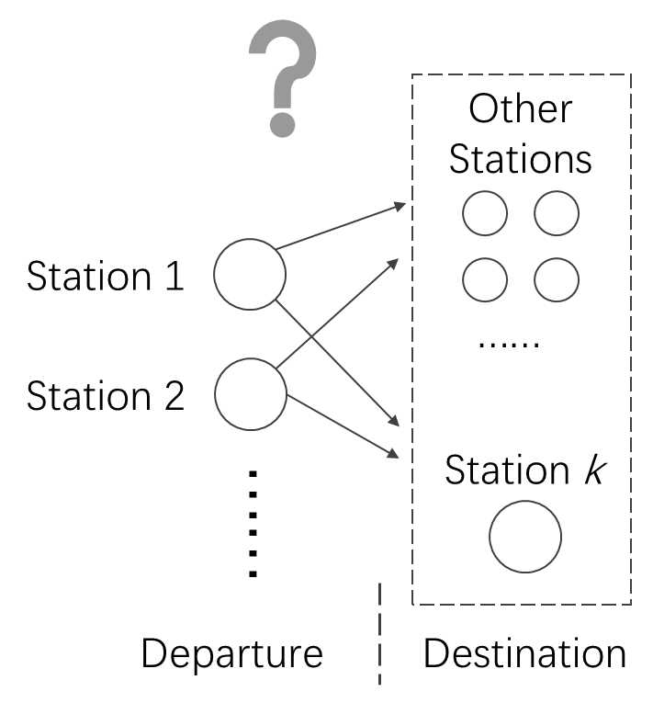
5.4
Method
Mathematical problems
Passenger flow
Binary choice model
$$P_{k}=F\left(x_{1}, x_{2},x_{3}, ……\right)$$
Probability of getting off at the specific station
Explanatory variable for making the choice of whether getting off
Logistic regression model
Chapter 5 - Influencing Factors on Transit Ridership at Station-to-Station Level
Notes:
Now we have prepared the dependent and explanatory variables, we need a model to establish the functional relationship between them.
Because the dependent variable is the probability of getting off at a specific station, this issue can be viewed as a binary choice problem. This is the abstract function, it can be estimated using logistic regression model.

Slide 67
5.4
Method
Selection of sample station
Population density
Person/ha
Land use type
Downtown
98
Office
173
Education
83
High-density residence
135
Low-density residence
69
Chapter 5 - Influencing Factors on Transit Ridership at Station-to-Station Level
Notes:
Because what we want to know is how land use affect the choice of destination, here I select some typical stations as the destination to estimate this influence.
According to the classification in the chapter 3, we select 5 stations from 5 types respectively.
They are Tenjin station of downtown type, Gofukumachi station of office type, Hakozakikyudaimae station of education type, Fujisaki station of high-density residence type, Kamo station of medium-density residence type.
We can see the five stations have significant features in land use composition.

Slide 68
5.5
Estimation
Probability of choosing the station as the destination
Factors of the departure stations
Bus accessibility
Bus capacity
Distance
Land use aggregation
Education land use
Residence land use
Office land use
Commerce land use
賀茂
藤崎
箱崎九大前
Factors of the departure stations
Bus accessibility
Bus capacity
Odd ratio
Distance
Increase in probability
Land use aggregation
Education land use
Decrease in probability
Residence land use
Office land use
Commerce land use
呉服町
天神
Chapter 5 - Influencing Factors on Transit Ridership at Station-to-Station Level
Notes:
Now let’s check how the land use of departure station can influence the probability of choosing these 5 stations as the destination.
The solid square means the corresponding indicator of the departure stations can lead an increase in the probability of choosing this target station as the destination, while the hollow square represents a decrease in this probability.

Slide 69
5.6
Conclusion
Findings
Passengers are not inclined to choose a destination station which has a similar land use type with that of the departure station.
A station belongs to low-density residence type has a low probability being chosen as the destination no matter how the land use of departure station varies.
For any type of stations, the increase in the education land use of the departure station can lead to an increase in the probability of choosing the target station as the destination.
Chapter 5 - Influencing Factors on Transit Ridership at Station-to-Station Level
Notes:
According to the result of estimation, we got some findings. They can be summarized as following:
1. Passengers are not inclined to choose a destination which has a similar land use type with that of the departure station.
2. A station belongs to low-density residence type has a low probability being chosen as the destination no matter how the land use of departure station varies.
3. For any type of stations, the increase in the education land use of the departure station can lead to an increase in the probability of choosing the target station as the destination.

Slide 70
5.5
Conclusion
Summary
Problems
Achievements
Described the passenger flow using the probability of choosing a specific destination station.
1
Description for the process of passenger flow needs to be clear.
2
The model should be able to reflect the influence extent of the indicators.
The problem is converted into a binary choice question. Logistic regression is used to estimate the influence of land use on the choice of destination
Chapter 5 - Influencing Factors on Transit Ridership at Station-to-Station Level
Notes:
The summary for the main achievements.
First one, this study described the passenger flow using the probability of choosing a specific destination station.
Secondly, converted this issue into a binary choice question, then estimated the influence of land use on the choice of destination using logistic regression model.

Slide 71
Chapter 6
Conclusion
Notes:
This is the contents of chapter 5. Finally, chapter 6, the conclusion.

Slide 72
6.0
Conclusion
Review of the subtopics
Reduction in share rate of public transit
Traffic congestion
Problems
Demand
Promoting the use of public rail transit
Exploring the determinants on the utilization of rail transit
Purpose
Walking duration to rail transit stations
Ridership of a single station
Ridership flow between station and station
Subtopic
Chapter 1 - Introduction
Notes:
Centering the main purpose of exploring the determinants on the utilization of rail transit, this research focused on 3 subtopics, walking duration to rail transit stations, transit ridership of single station, passenger flow between station and station.

Slide 73
6.0
Conclusion
Walking duration to transit stations
Described passengers' walking duration preferences by examining the probability of certainly accepting a given threshold of walking duration to transit stations.
The effect of influencing factors is predicted, the results are evaluated from the view of both individual and group.
Chapter 6 - Conclusion
Notes:
In the topic of walking duration to transit stations,
This research described passengers' walking duration preferences by examining the probability of certainly accepting a given threshold of walking duration to transit stations;
Then the preference of walking duration was predicted, and the results are evaluated in both individual and group.

Slide 74
6.0
Conclusion
Influencing factors of transit ridership (station level)
Reorganized the indicator system. Proposed the indicators of land use variety, bus capacity and bus accessibility.
To reduce first and second type of statistical error in small samples, use exploratory regression to screen effective indicators and the most metric combinations.
Identified global/local indicator in MGWR using the spatial autocorrelation of indicators.
Chapter 6 - Conclusion
Notes:
In the topic of Influencing factors of transit ridership at station level,
Firstly, this study redefined the indicators of land use variety and the indicators of bus system.
Secondly, this study used exploratory regression to screen effective indicators and the most metric combinations.
Thirdly, proposed an approach to identify the global/local indicator in MGWR.

Slide 75
6.0
Conclusion
Influencing factors of transit ridership (station-to-station level)
Described the passenger flow using the probability of choosing a specific destination station.
The problem is converted into a binary choice question. Logistic regression is used to estimate the influence of land use on the choice of destination station.
Chapter 6 - Conclusion
Notes:
In the topic of Influencing factors of transit ridership at station-to-station level,
this research described the passenger flow using the probability of choosing a specific destination station.
Then constructed a binary choice model to describe the passenger flow between station and station, and estimated the influence of land use on the choice of destination station.

Slide 76
Thanks
Notes:
That’s all for my presentation, thanks for paying attention.

Slide 77
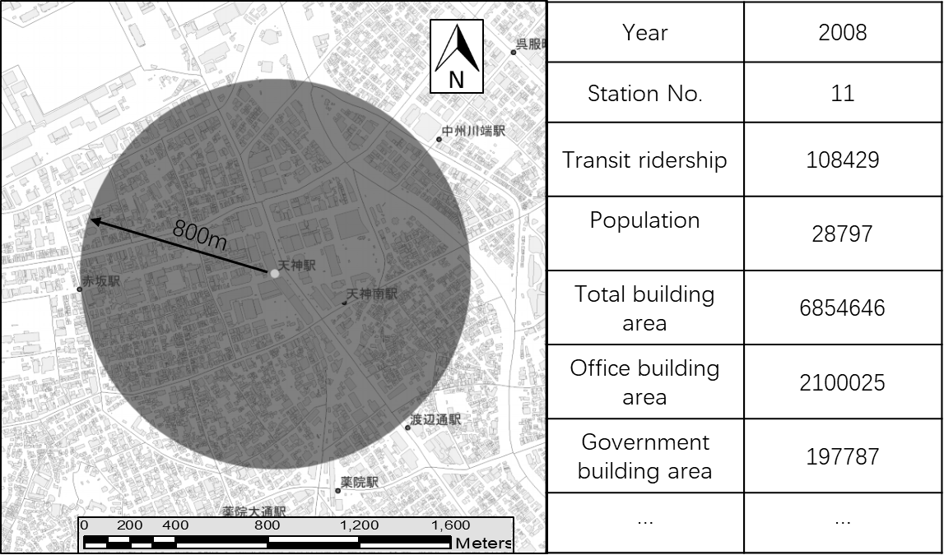
3.2
Data
Data extraction
1. Matching the region of data.
2. Matching the time points of data.
3. Extracting the data within the catchment area.
Chapter 3 - Analysis on the characteristics of transit ridership and land use
Notes:
This is the procedure of data extraction.
1. Matching the region of data.
2. Matching the time points of data.
3. Extracting the data within the catchment area.

Slide 78
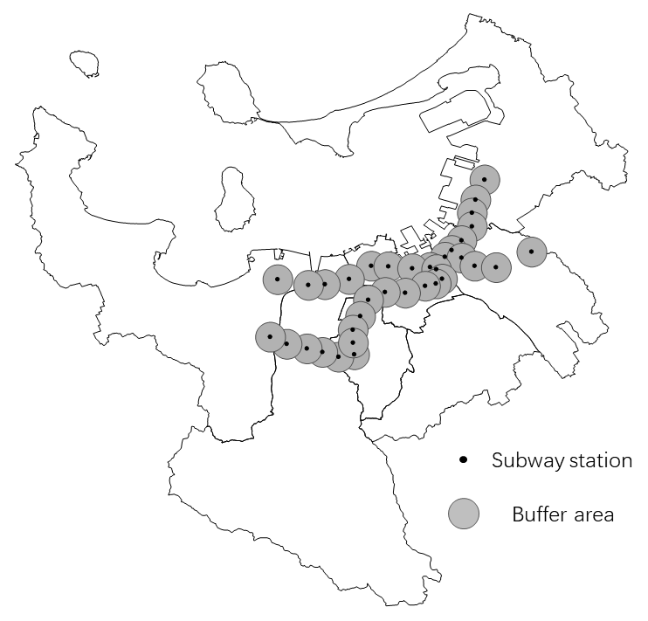
3.3
Characteristics of transit ridership and land use
Land use characteristics
Data extraction
ArcGIS
800m-radius region
Extracting data
Main land use
Business
Commerce
Hotel
Entertainment
Residence
Apartment house
Dwelling with shop
Government
Education
Culture
Chapter 3 - Analysis on the characteristics of transit ridership and land use
Notes:
Then I will give an analysis on the land use characteristics.
The data of land use is extracted using an 800 meters radius region around the stations. The land use mainly includes the following types.

Slide 79
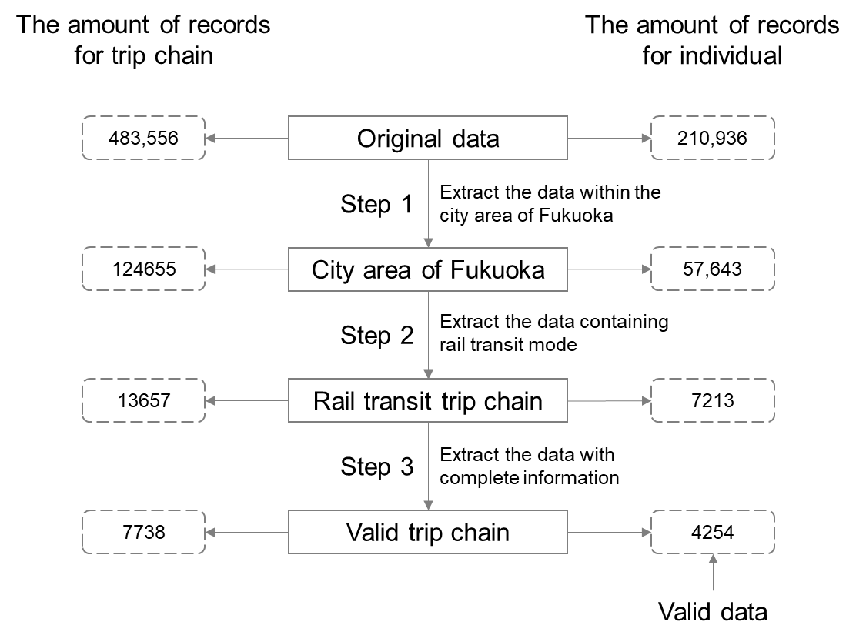
2.3
Data
Data processing
Data Source: Person Trip Survey
Chapter 2 - Analyzing Willingness of Walking Duration to Transit Stations Using Socio-Demographic Characteristics
Notes:
This is the data processing. The original data covers all the main cities in Kitakyushu area with more than four hundred thousands records.
I set the filter with city area of Fukuoka, rail transit trip chain, without null records, the remaining valid dataset has 4000 records.

Slide 80
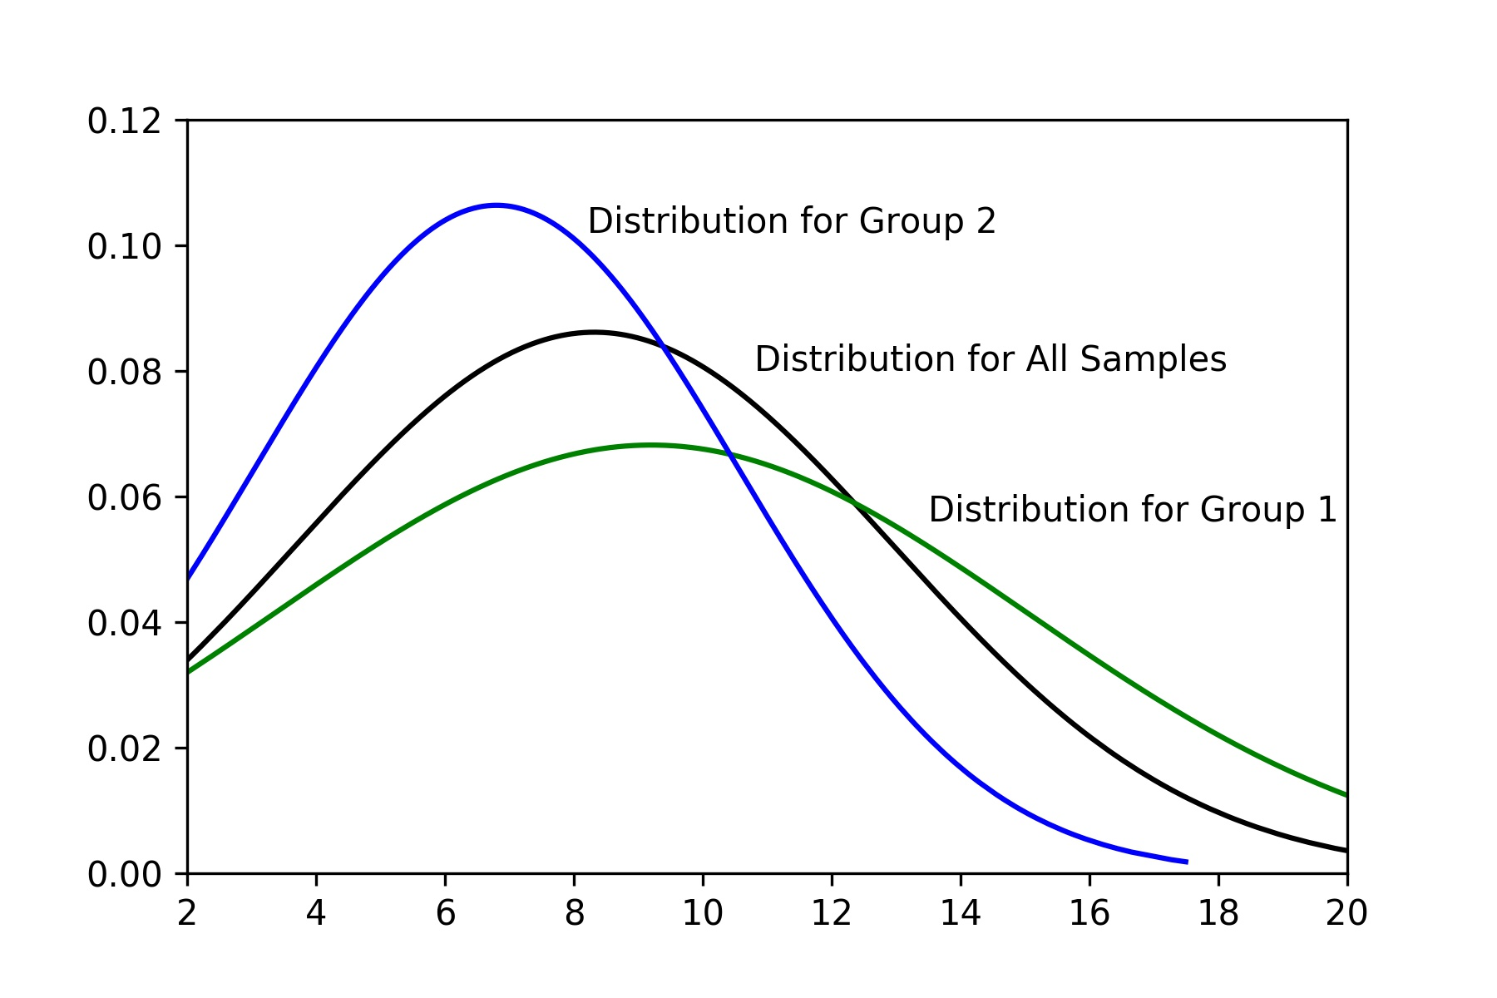
2.2
Methods
Important assumption
Group 1
Group 2
Probability
All Samples
6 min
If considering the threshold of 6 minutes
minute
Assuming the distribution of walking duration of the passengers with the same attributions subject to the normal distribution.
If the survey result obtained from the questionnaire showed one group of passengers with specific attributes tend to walk longer, it means this group of passengers can accept a longer walking duration.
In this graph it can be considered that Group 1 can accept a longer walking duration than Group 2.
Chapter 2 - Analyzing Willingness of Walking Duration to Transit Stations Using Socio-Demographic Characteristics

Slide 81
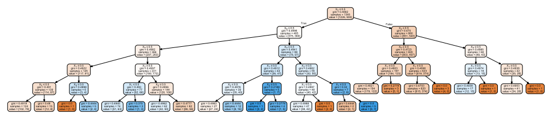
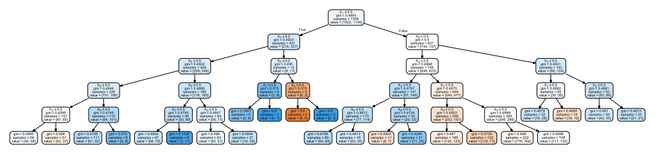
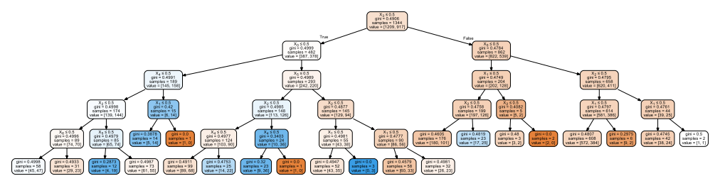
2.5
Evaluation of features
Prediction
Individual Value |  | Group Trend
Actual | Prediction | Actual | Prediction
1 | 1.000 | 0.654 | 0.637
1 | 0.897 | 0.653 | 0.636
1 | 0.897 | 0.651 | 0.635
… | … | … | …
0 | 0.621 | 0.581 | 0.580
1 | 0.621 | 0.581 | 0.579
1 | 0.621 | 0.580 | 0.579
… | … | … | …
0 | 0.498 | 0.435 | 0.411
1 | 0.496 | 0.437 | 0.411
1 | 0.496 | 0.434 | 0.410
… | … | … | …
200 records
Average
The predicted result is probabilities of accepting the giving threshold of walking duration.
The accuracy of results are evaluated by using the method of simple moving average.
Simple moving average
Chapter 2 - Analyzing Willingness of Walking Duration to Transit Stations Using Socio-Demographic Characteristics
Notes:
The result of decision tree is as shown in the figure. Here I just give a summary of the result to show.
As shown in the table on the right part, column of actual is the actual choice of individual, the prediction column is the value obtained from the estimation of decision tree.
The results are evaluated by using the method of simple moving average.
Sort the result by probability in descending order, the group trend is expressed by the average value of 200 samples.
So the trends between practice and prediction can be compared.

Slide 82
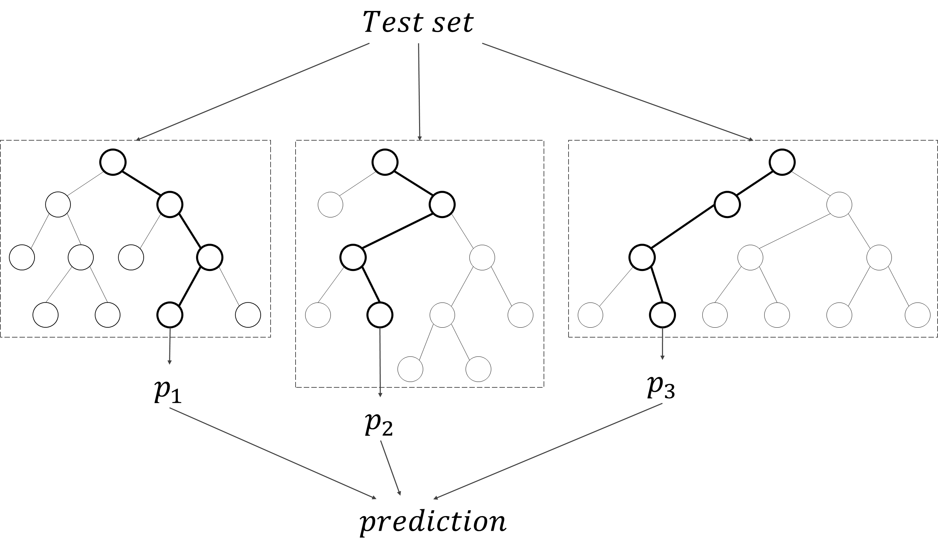
2.5
Estimation of Features
Decision tree and forest random
Forest random model is constructed by random selection of features and samples based on decision tree model.
The result is obtained by the average value of multiple decision trees.
Chapter 2 - Analyzing Willingness of Walking Duration to Transit Stations Using Socio-Demographic Characteristics
Notes:
Now we have got the valid features, the next step is to estimate the model to obtain the influence of the features on the acceptable walking duration.
I used the forest random decision tree model in this study.
Forest random model is constructed by random selection of features and samples based on decision tree model.
The result is obtained by the average value of multiple decision trees.

Slide 83
2.7
Conclusion
Recommendations
Encourage office buildings to move close to stations
Results from the factors of business purpose and going home purpose. Office staff tend to access rail transit station in a shorter time.
The individual prediction is still not accurate enough for predicting individual behavior. But the group prediction can be used for mastering the overall trend of rail transit utilization in a block.
Results from the evaluation of prediction
Chapter 2 - Analyzing Willingness of Walking Duration to Transit Stations Using Socio-Demographic Characteristics
Notes:
With the goal of increasing rail transit ridership, some recommendations are proposed based on the result. First, it is recommended to encouraging office building to move close to stations, because office staff tends to access rail transit station in a shorter time. Second, even the individual prediction is still not accurate enough for predicting individual behavior, the prediction of group trends can be used for mastering the overall trend of rail transit utilization in a block level.

Slide 84
4.1
Introduction
Influencing factors
Catchment area
Land use
Facilities
Social-economic
……
Extraction
Impact on the transit ridership
Chapter 4 - Influencing Factors on Transit Ridership at Station Level

Slide 85
4.4
Identification of valid factors
Valid factors
Suggested value
VIF< 7.5; Validity > 10%; Stability >90%
Category | Variable | Statistical Information
 |  | VIF | Validity | stability | times | + | -
 | Total |  |  |  | 367 | 253 | 114
Built environment | Commerce Area | 8.8 | 32.1% | 100.0% | 25 | 25 | 0
 | Office Area | 10.4 | 9.0% | 71.4% | 7 | 5 | 2
 | Residence Area | 27.5 | 12.8% | 70.0% | 10 | 7 | 3
 | Education Area | 1.8 | 7.7% | 100.0% | 6 | 6 | 0
 | Government Area | 1.8 | 42.3% | 100.0% | 33 | 33 | 0
 | Transportation Facility | 3.0 | 67.9% | 100.0% | 53 | 53 | 0
 | Land use Aggregation | 2.5 | 50.0% | 100.0% | 39 | 39 | 0
Transportation Accessibility | Transfer Dummy | 3.0 | 34.6% | 100.0% | 27 | 27 | 0
 | Bicycle Parking | 4.5 | 44.9% | 100.0% | 35 | 35 | 0
 | Bus Capacity | 6.6 | 37.2% | 96.6% | 29 | 1 | 28
 | Bus Accessibility | 6.8 | 19.2% | 100.0% | 15 | 15 | 0
 | Road Density | 2.3 | 1.3% | 100.0% | 1 | 1 | 0
Demographic Socioeconomic Environment | Population | 23.9 | 12.8% | 60.0% | 10 | 6 | 4
 | Household Members | 3.0 | 39.7% | 100.0% | 31 | 0 | 31
 | Population/Job Balance | 3.0 | 37.2% | 100.0% | 29 | 0 | 29
 | Tenant Proportion | 2.2 | 21.8% | 100.0% | 17 | 0 | 17
Valid Variable
The cell marked with dark color means that it doesn’t meet the judgment.
Chapter 4 - Influencing Factors on Transit Ridership at Station Level
Notes:
As to the procedure of screening valid factors, simply speaking, three judgments are used to identify the valid variables, they are multicollinearity, validity, and stability.
The indicators with the VIF less than 7.5, the validity more than 10%, and the stability more than 90% is viewed as valid.

Slide 86
4.4
Identification of effective factors
Optimal combination of factors
Independent variables | Test model
 | Beta | Sig | VIF
Government Area | 0.10 | 0.02 | 1.36
Transportation Facility Area | 0.20 | 0.00 | 2.31
Land use Aggregation | 0.10 | 0.03 | 1.42
Bicycle Parking | 0.46 | 0.00 | 2.60
Bus Capacity | -0.20 | 0.01 | 3.56
Bus Accessibility | 0.26 | 0.00 | 4.71
Transfer Dummy | 0.26 | 0.00 | 2.79
Population/Job Balance | -0.10 | 0.05 | 1.94
Tenant Proportion | -0.09 | 0.03 | 1.32
Household Members | - | - | -
Residual sum of squares | 337744990
Adjusted R² | 0.96
AICc | 694.39
Jarque-Bera test (Sig) | 0.61
Koenker (BP) test (Sig) | 0.85
SA test (Sig) | 0.27
No biased standard errors due to heteroscedasticity
Not deviating from a normal theoretical distribution
Not spatial autocorrelated
Chapter 4 - Influencing Factors on Transit Ridership at Station Level
Notes:
In the second step, the linear regression is conducted again to select an optimal combination of valid explanatory variables.
The judgement is the statistical test for regression.
As shown in this table, there are 9 valid variables entering the model at last.

Slide 87
4.6
Conclusion
Findings
Factors increasing ridership
Factors decreasing ridership
Government Area
Transport Area
Land Use Aggregation
Transfer Dummy
Bicycle Parking
Bus Accessibility
Bus Capacity
Population/Job Balance
Tenant Proportion
Chapter 4 - Influencing Factors on Transit Ridership at Station Level
Notes:
The main findings of this study can be summarized as following.
High diversity of land use can lead to decrease in transit ridership.
The bus system has both positive and negative effects on rail transit ridership.
The tenants are more willing to use rail transit.

Slide 88
4.6
Conclusion
Recommendation
Add bicycle parking
- Results from the indicator of bicycle parking
As to the bus lines and frequency, reduce the overlap rate between bus lines and rail transit lines, improve the transfer function of bus system
- Results from the indicator of bus accessibility and bus capacity
Encourage new construction of apartments around the rail transit station
- Results from the indicator of tenant proportion
Chapter 4 - Influencing Factors on Transit Ridership at Station Level
Notes:
Some recommendations are given according to the result. To increase the utilization of rail transit, it is recommended to adding bicycle parking to attract more passengers who ride bicycles. Reducing the overlap rate of bus lines and rail transit lines can help increase rail transit ridership. And, building apartments around the rail transit station can help increase the utilization of rail transit.

Slide 89
5.1
Introduction
Background
Station level
Station-to-station level
Chapter 5 - Influencing Factors on Transit Ridership at Station-to-Station Level
Notes:
At the beginning, I want to repeat it once again that why I focus on the ridership between station and station.
There is a station A, if the ridership of station A varied because of the variation in the elements within the catchment area of station A, it is obvious, the transit ridership of station B will also vary, because station A is connecting with station B, the variation of transit ridership in Station A must bring new variation in Station B.
With this issues, the purpose of this study is proposed, Exploring how the factors of land-use influence the choice of destination station for passengers from the perspective of TOD

Slide 90
5.6
Conclusion
Recommendations
It is recommended paying more attention to the location of rail transit stations while judging the site selection of a newly planned school.
- Results from finding 3
For low-density residence type stations, it is recommended that promoting the utilization of rail transit could start with other measures, such as fare adjustment.
- Results from finding 2
Chapter 5 - Influencing Factors on Transit Ridership at Station-to-Station Level
Notes:
Based on the findings in this study, some recommendations can be raised for future planning.
It is recommended paying more attention to the location of rail transit stations while judging the site selection of a newly planned school.
For low-density residence type stations, it is recommended that promoting the utilization of rail transit could start with other measures, such as fare adjustment.

Slide 91
5.1
Introduction
Passenger flow between two stations is determined by the transit ridership of both the two stations.
Passenger flow will not increase with the increase of transit ridership in station B.
Station A
Passenger flow
Station B
Transit ridership
Station B >> Station A
Chapter 5 - Influencing Factors on Transit Ridership at Station-to-Station Level
Notes:
Because the passenger flow between two stations is not only determined by one station, it is affected by the transit ridership of both two stations.
I’d like to show an example to help explain it.
Now if we investigate two stations, A and B. Station A has a small scale of transit ridership, but the transit ridership of station B is much larger than that of station A. Limited by the transit ridership of station A, the passenger flow will not always increase with the increase of transit ridership in station B.

Slide 92
6.0
Conclusion
Summary
Based on the theme of exploring the determinants on rail transit utilization in Fukuoka City, this study discussed 4 major issues.
One
Chapter 2 discussed how the walking duration to rail transit station is affected by passenger attributes. Centering with this topic, 3 specific research questions are proposed according to the previous studies, then the answers to each question were given.
Chapter 6 - Conclusion

Slide 93
6.0
Conclusion
Summary
Based on the theme of exploring the determinants on rail transit utilization in Fukuoka City, this study discussed 4 major issues.
Two
Chapter 3 summarized the characteristics of rail transit ridership and land use in the case of Fukuoka, which helped to make a comprehensive understanding of the research object in this dissertation. This chapter also gave some important reference and implication for the next research.
Chapter 6 - Conclusion

Slide 94
6.0
Conclusion
Summary
Based on the theme of exploring the determinants on rail transit utilization in Fukuoka City, this study discussed 4 major issues.
Three
Chapter 4 explored and estimated the influencing factors on rail transit ridership at the station level. With the focus on the case of Fukuoka with small sample size, this chapter proposed improved approach from indicator system, valid indicator selection, and model estimation three aspects, and the results are proved effective and improved.
Chapter 6 - Conclusion

Slide 95
6.0
Conclusion
Summary
Based on the theme of exploring the determinants on rail transit utilization in Fukuoka City, this study discussed 4 major issues.
Four
Chapter 5 gave a description for the passenger flow between station and station that use the land use type around a station to explain the probability of choosing that station as the destination station. Then ran logistic regression to estimate the influence of land use on the probability of getting off at the destination station. The influence of land use on the transfer of ridership between station and station is confirmed in this chapter.
Chapter 6 - Conclusion

Slide 96
6.2
Recommendations
Application of the achievements
Estimation of catchment area
PSDC data in the blocks
A
5 min
input
7 min
B
Model
11 min
Station
The trend (probability) of using this station in the blocks can be mastered.
C
Block
Estimating the catchment area
output
Prediction of transit ridership
Using the estimated catchment area to make prediction of transit ridership
Using the results of ridership transfer between station and station to correct the prediction of ridership at single station
Chapter 2 - Analyzing Willingness of Walking Duration to Transit Stations Using Socio-Demographic Characteristics
Notes:
Now we get the conclusion of this study.
In summary, this study estimated the probability of accepting the given threshold of waling duration to rail transit stations.
Well, what can we do with this achievement?
As this figure, for example we have a station in the center, and three blocks around this station, the distances to this station are not the same for the 3 stations. Now if we have the data of personal attributes in each block, we can input this dataset into the model discussed in this study, and then get the trend of using this station in each block.
With this output, obviously, the catchment area of the station can be estimated.
This is the contents of chapter 2.

Slide 97
0.0
Organization
Chapter 1
Introduction
Analyzing Willingness of Walking Duration to Transit Stations Using Socio-Demographic Characteristics
Chapter 2
Analysis on the characteristics of transit ridership and land use
Chapter 3
Influencing Factors on Transit Ridership at Station Level
Chapter 4
Influencing Factors on Transit Ridership at Station-to-Station Level
Chapter 5
Chapter 6
Conclusion
Notes:
At the first, I want to give an overview for the organization.
This dissertation is organized by 6 chapters.
Chapter 1 is introduction….

Slide 98
1.3
Research contents
Main purpose
Exploring the factors influencing rail transit ridership from multiple perspectives and estimating the influence.
Research questions
Clarifying the characteristics of ridership and land use
Exploring the factors influencing Walking duration
Question
Chapter 3
Question
Utilization of rail transit
Chapter 2
Chapter 5
Question
Chapter 4
Exploring the factors influencing the ridership transfer between station and station
Question
Exploring the factors influencing the ridership at station level
Chapter 1 - Introduction
Notes:
With these transportation problems, it’s clear that we have the demand to promote the use of public transit.
And that is what I want to talk about in this dissertation.
The theme is to explore the influencing factors of rail transit ridership.

Slide 99
1.1
Background
Problems
1
2
3
Reduction in share rate of public transit
Aging population
Traffic congestion
Chapter 1 - Introduction
Notes:
This research uses the Fukuoka public rail transit as the study case to examine the influencing factors on ridership.
At the very beginning, I’d like to give an introduction of the background in Fukuoka.
Nowadays, even though Fukuoka is still in a rapid growth, there are also many social problems that Fukuoka is facing now.
One of that is the aging population, this figure gives the prediction of Fukuoka’s population in tens years. As we can see, The population of that in production age has reached the peak recently, and the total population will reach the peak in ten years. The population structure is not optimistic in Fukuoka.

Slide 100


1.1
Background
How is the research topic proposed ?
Developing Countries
Developed Countries
Urbanization
Congestion, pollution
Lack of resources
Aged society
Low birthrate
Fiscal burden
Status quo
Increasing supply
Improving financial situation
Demand
sustainability
Measure
Increase public transportation utilization
Topic
Exploring the determinants of rail transit ridership
Chapter 1 - Introduction
Notes:
As we know, nowadays, most of the cities either in developing countries or developed countries, are facing somewhat social problems. I can give a familiar and obvious instance, my country, China, now is still at the period of rapid urbanization, many problems like traffic congestion, air pollution, are not solved yet, while Japan, where now I’m living in, has totally different social problems, like serious aged society, low birthrate, heavy fiscal burden. Therefore, the developing countries like China have more demands on resource and environment protection, while developed countries like Japan need to improve financial situation. However, the demands of both developing and developed country can be viewed as sustainability. For this common demand, promoting public transportation is widely accepted as one of the most important measures.
With the goal of increasing public transportation utilization, the topic was proposed, that is exploring the determinants of rail transit ridership.

Slide 101
1.2
Research purpose
Primary questions
1
What influence the walking duration to transit stations?
Walking duration
1
Station
Station
Ridership
Ridership
2
3
2
What factors explain transit ridership at station level?
3
What factors influence the transit ridership between station and station?
Chapter 1 - Introduction
Notes:
0. Around this topic, there are 3 primary questions to answer.
1. The first one is what influence the walking duration to transit stations? Since most travel accessing the transit station is walking, the walking duration should be one of the most important factors influencing the ridership.
2. The second is what factors explain transit ridership at station level? As we know, the environment around a station of cause can affect the ridership of this station, so our aim is to find and estimate the influencing factors.
3. Based on the second question, because stations are in the network, the ridership in one of the stations varied, the ridership in other stations must vary as well. Here the third question is proposed, that is what factors influence the transit ridership between station and station.
00. These are the primary questions in this dissertation

Slide 102
1.3
Literature review
Year |  | 2004 | 2004 | 2009 | 2010 | 2011 | 2012 | 2013 | 2013 | 2015
Author |  | Chu | Kuby et al. | Taylor et al. | Sohn and Shim | Gutiérrez et al. | Cardozo et al. | Chakraborty et al. | Zhao et al. | Jun et al.
Catchment (walking distance) |  | 400m walking distance | 800m walking distance | N/A | N/A | Distance-decay 800m buffer | 800m walking distance | N/A | 800m radius | 300m,600m,900m radius
Method |  | Poisson Regression | WLS | 2SLS | OLS/SEM | OLS | OLS/GWR | OLS/SEM | OLS | OLS/MGWR
Sample Size |  | 2568 | 268 | 265 | 251 | 158 | 190 | 900 | 55 | 442
Number of Valid Indicator |  | 15 | 11 | 8 | 7 | 9 | 4 | 9 | 11 | 11
Coefficient of determination (Adjusted R²) |  | 0.54 | 0.71 | 0.91 | 0.60 | 0.73 | 0.56 | 0.69 | 0.95 | 0.77
Building environment | Built environment |  |  |  | ● | ● |  | ● | ● | ●
 | Hospital |  |  |  |  |  |  |  | ●
 | School/University |  |  |  | ● |  |  |  | ●
 | CBD |  | ● |  |  |  |  |  | ●
 | Land use mix |  |  |  | ● | ● | ● |  |  | ●
 | Other infrastructures |  | ● |  |  |  |  |  | ● | ●
Transportation Accessibility | Accessibility of pedestrian | ● |  |  |  |  |  | ●
 | Accessibility of transfer |  | ● |  | ● | ● | ● | ● | ● | ●
 | Road coverage |  |  | ● | ● |  |  |  | ●
 | Parking |  | ● |  |  |  |  |  | ●
 | Service level of public transit | ● | ● | ● |  | ● | ● |  | ● | ●
 | Locational factor |  | ● |  | ● |  |  |  | ●
Demographic and Socioeconomic Environment | Population |  | ● | ● | ● |  | ● | ● | ● | ●
 | Employment | ● | ● | ● | ● | ● | ● | ● | ● | ●
 | Age | ● |  | ● |  |  |  |  |  | ●
 | Tenant proportion |  | ● |  |  |  |  |  |  | ●
 | Race | ● | ● | ● |  | ●
 | Income | ● |  |  |  |  |  | ●
 | Vehicles holdings | ● |  |  |  |  | ● | ●
 | Fare |  |  | ●
Points discussed in previous studies
Catchment area
Model
Indicator system
Lack of consideration
Small sample case
The ridership between station and station
Chapter 1 - Introduction
Notes:
With the primary questions, I will give an overview of the previous studies.
Most studies paid the concentration on catchment area, model construction and estimation, and the indicator system.
But very few studies focus on the small sample case and the ridership transfer between station and station.

Slide 103
1.4
Research contents
Specific research topic
1
Exploring the willingness of walking duration to transit stations regarding passengers’ personal attributes.
Chapter 2
2
Analyzing the characteristics in the variation of transit ridership.
Chapter 3
3
Exploring the approach of screening effective influencing factors in small sample case
Chapter 4
4
Shifting the research perspective, trying to describing the variation of ridership between stations and stations.
Chapter 5
Chapter 1 - Introduction
Notes:
Based on the research purpose and previous studies, 4 specific research topics are proposed, corresponding to the chapters from 2 to 5.
Chapter 2 is Exploring the willingness of walking duration to transit stations regarding passengers’ personal attributes.
Chapter 3 is Analyzing the characteristics in the variation of transit ridership.
Chapter 4 is Exploring the approach of screening effective influencing factors in small sample case
Chapter 5 is Shifting the research perspective, trying to describing the variation of ridership between stations and stations.
This is the introduction of my dissertation.

Slide 104
1.2
Research purpose
Main purpose
Explore the determinants of rail transit ridership
Giving reference for increasing the rail transit ridership
Subject topics
What determines catchment area?
What factors explain transit ridership at station level?
What factors influence transit ridership among stations?
Chapter 1 - Introduction
Notes:
With this topic, I will interpreter the research purpose in details. The main purpose of this research can be briefed to exploring the determinants of rail transit ridership, thus giving reference for increasing the rail transit ridership.
In details, the subject topics discussed in this research mainly have 3 parts. They are, what determines catchment area, what factors explain transit ridership at station level, what factors influence transit ridership among stations.

Slide 105


2.1
Introduction
Research position
Catchment area
Influencing factor
The area passengers can accept to walk to the station
Environment
Behaviors
Personal Socio-Demographic Characteristics
(abbreviated as PSDC)
Walking duration to transit stations
Relationship
Research Point
(This Study)
Chapter 2 - Analyzing Willingness of Walking Duration to Transit Stations Using Socio-Demographic Characteristics
Notes:
Before I introduce this research, I want to give a brief position for it. As we know, obviously, the catchment area is a basic determinants for the use of transit station. According to the previous research, catchment area should be determined by various factors, like built-environment, facilities, also people’s behaviors. In this research, we chose the perspective of people’s behaviors to investigate how the catchment area is determined. The walking duration and personal socio-demographic characteristics are used to represent the catchment area and people’s behaviors, respectively.

Slide 106
2.1
Introduction
Research position
Acceptable walking duration to rail transit stations
Behaviors
Catchment area
Determine
Walk to the station
Personal attributes
Socio-demographic characteristics
(abbreviated as PSDC)
Walking duration to transit stations
Research purpose
How the socio-demographic characteristics influence the acceptable walking duration
Chapter 2 - Analyzing Willingness of Walking Duration to Transit Stations Using Socio-Demographic Characteristics
Notes:
Since pedestrian accounts most rail transit users, the walking distance and duration can determine the catchment area to a large extent. And the walking duration is thought to be affected by the behavior preference, which should be affected by personal attributes like socio-demographic characteristics.
Now we can carry out the main research purpose, How the socio-demographic characteristics influence the acceptable walking duration?

Slide 107
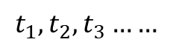
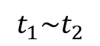
2.1
Introduction
The work of this study
Research purpose
Explore how the PSDC can affect the acceptable walking duration to transit stations using the data of person trip survey.
Research object
Examine the probability of accepting the given threshold of walking duration
Continuous value of Walking duration
Threshold of walking duration
$$t_{1}\sim t_{2}$$
$$t_{1}, t_{2}, t_{3}……$$
Entry point
Try to explain the acceptable walking duration using probability.
Chapter 2 - Analyzing Willingness of Walking Duration to Transit Stations Using Socio-Demographic Characteristics
Notes:
With the interpretation of the existing problems in previous studies, here the research purpose is proposed, that is to explore how the personal socio-demographic characteristics can affect the acceptable walking duration to transit stations using the data of person trip survey.
And different from the existing studies, I investigate the walking duration by some specific threshold value rather than the continuous value. Moreover, the estimation of relationship is not from the perspective of regression but the probability.
That is to say, I will check the probability of choosing walking to transit stations at some specific threshold.

Slide 108
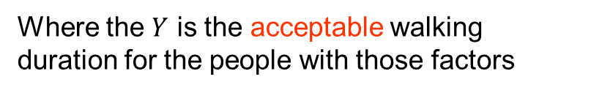
2.1
Introduction
Research object
$$Y=F\left({factor}_{1}, {factor}_{2},{factor}_{3}, ……\right)$$
Acceptable walking duration
Where the $Y$ is the acceptable walking duration for the people with those factors
Examine the probability of accepting the given threshold of walking duration
Continuous value of Walking duration
Threshold of walking duration
$$t_{1}\sim t_{2}$$
$$t_{1}, t_{2}, t_{3}……$$
Entry point
Try to explain the acceptable walking duration using probability.
Chapter 2 - Analyzing Willingness of Walking Duration to Transit Stations Using Socio-Demographic Characteristics
Notes:
With the interpretation of the existing problems in previous studies, here the research purpose is proposed, that is to explore how the personal socio-demographic characteristics can affect the acceptable walking duration to transit stations using the data of person trip survey.
And different from the existing studies, I investigate the walking duration by some specific threshold value rather than the continuous value. Moreover, the estimation of relationship is not from the perspective of regression but the probability.
That is to say, I will check the probability of choosing walking to transit stations at some specific threshold.

Slide 109
2.4
Selection of valid features
Selection of thresholds
According to the existing studies, the acceptable walking duration mainly range from 5 – 13 minutes.
In this study, the average walking duration is about 8 minutes.
The thresholds selected in this study is 5, 8, 13 minutes.
Analysis of variance
L : tend to spend Less than the threshold
M: tend to spend more than the threshold
Valid Features at each threshold
Chapter 2 - Analyzing Willingness of Walking Duration to Transit Stations Using Socio-Demographic Characteristics
Notes:
It has been said in the former slides, the research objects are some specific threshold of walking durations.
According to the previous research and the investigation of Fukuoka, the acceptable walking duration mainly range from 5-13 minutes, and the average duration is about 8 minutes in Fukuoka.
Therefore, the threshold of walking duration to be investigated are set to 5, 8. 13 minutes.
Regarding the three thresholds, I picked the valid factors at each threshold, by using the analysis of variance.
For this table, in the column of effect, the cell marked with L means people with this attributes tend to accept a longer time than this threshold, M is the opposite.
For example, at the 5 minutes threshold, we can see that passengers who has the attributes of peak hour, and purpose of commuting to work tend to walk a less time than the given threshold of 5 minutes.

Slide 110
2.5
Evaluation of features
Prediction
Individual Value |  | Group Trend
Actual | Prediction | Actual | Prediction
1 | 1.000 | 0.654 | 0.637
1 | 0.897 | 0.653 | 0.636
1 | 0.897 | 0.651 | 0.635
… | … | … | …
0 | 0.621 | 0.581 | 0.580
1 | 0.621 | 0.581 | 0.579
1 | 0.621 | 0.580 | 0.579
… | … | … | …
0 | 0.498 | 0.435 | 0.411
1 | 0.496 | 0.437 | 0.411
1 | 0.496 | 0.434 | 0.410
… | … | … | …
200 records
Average
The predicted result is probabilities of accepting the giving threshold of walking duration.
The accuracy of results are evaluated by using the method of simple moving average.
Simple moving average
Chapter 2 - Analyzing Willingness of Walking Duration to Transit Stations Using Socio-Demographic Characteristics
Notes:
The result of decision tree is as shown in the figure. Here I just give a summary of the result to show.
As shown in the table on the right part, column of actual is the actual choice of individual, the prediction column is the value obtained from the estimation of decision tree.
The results are evaluated by using the method of simple moving average.
Sort the result by probability in descending order, the group trend is expressed by the average value of 200 samples.
So the trends between practice and prediction can be compared.

Slide 111
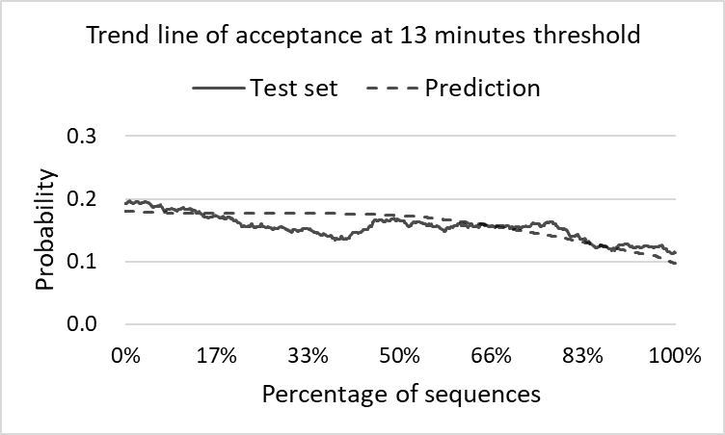
2.6
Result and Discussion
Evaluation of prediction
Evaluation of 13 minutes threshold
Slightly high precision
The threshold of 13 minute is not a commonly acceptable walking duration
Some one who can accept this threshold can be considered to have some specific characteristics.
The features are significant at this threshold.
Chapter 2 - Analyzing Willingness of Walking Duration to Transit Stations Using Socio-Demographic Characteristics
Notes:
Next is the evaluation at 13minutes threshold.
We can see the precision is neither good not bad.
A little like the result at 5 minutes threshold, because the threshold of 13 minute is not a commonly acceptable walking duration. Some one who can accept this threshold can be considered to have some specific characteristics. This significant difference from the other passengers explains this fitness at 13 minutes threshold.

Slide 112
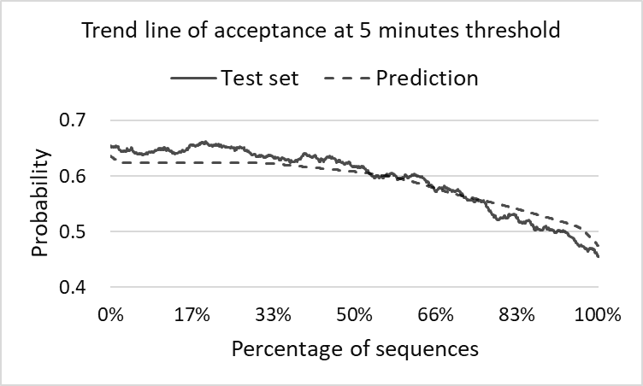
2.6
Result and Discussion
Evaluation of prediction
Evaluation of 5 minutes threshold
Good fitness
The features are significant at 5 minutes threshold.
The threshold of 5 minute is a commonly acceptable walking duration.
Chapter 2 - Analyzing Willingness of Walking Duration to Transit Stations Using Socio-Demographic Characteristics
Notes:
Continuously, I will show the trend line of prediction at each threshold of walking duration.
First is the 5 minutes threshold.
As we can see, the prediction trend line fit the actual trend line quite well, the features are significant at this threshold.
The threshold of 5 minute is a commonly acceptable walking duration

Slide 113
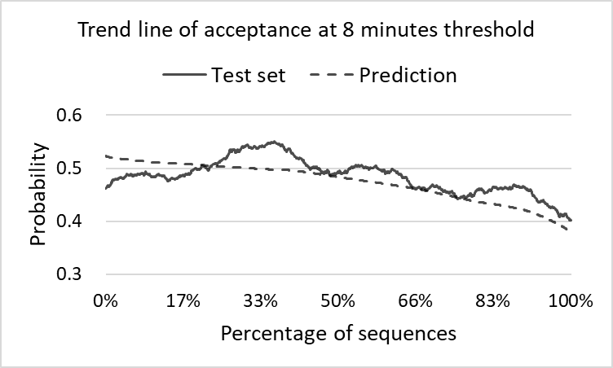
2.6
Result and Discussion
Evaluation of prediction
Evaluation of 8 minutes threshold
Low fitness
The features are not significant at 8 minutes threshold.
There is randomness in choosing whether accepting the 8 minutes walking duration or not.
Chapter 2 - Analyzing Willingness of Walking Duration to Transit Stations Using Socio-Demographic Characteristics
Notes:
Next is the 8 minutes threshold.
The fitness at 8 minutes is not well, the features are not significant at this threshold.
There is randomness in choosing whether accepting the 8 minutes walking duration or not.

Slide 114
2.6
Result and Discussion
Evaluation of prediction
Evaluation of 13 minutes threshold
Good fitness
The features are significant at 13 minutes threshold.
The threshold of 13 minute is not a commonly acceptable walking duration
Chapter 2 - Analyzing Willingness of Walking Duration to Transit Stations Using Socio-Demographic Characteristics
Notes:
The fitness at 13 minutes is not bad.
From the probability we can know the 13 minutes is not a commonly accepted walking duration.

Slide 115
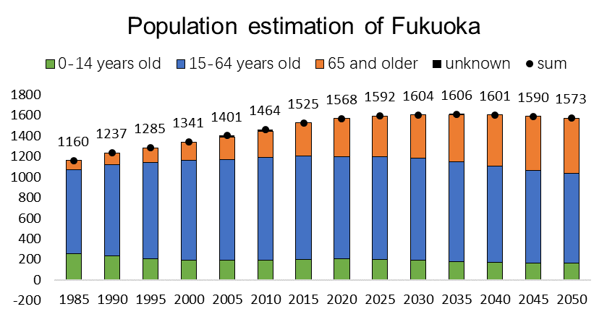
3.1
Introduction
Background
Problems
1
2
3
Reduction in share rate of public transit
Aging population
Traffic congestion
Chapter 3 - Analysis on the characteristics of transit ridership and land use

Slide 116
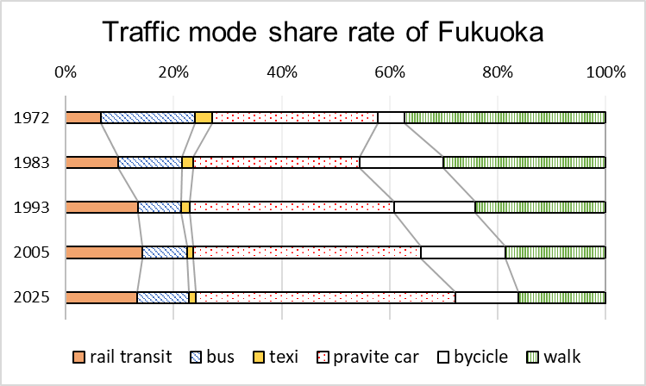
3.1
Introduction
Background
Problems
1
2
3
Reduction in share rate of public transit
Aging population
Traffic congestion
Chapter 3 - Analysis on the characteristics of transit ridership and land use

Slide 117
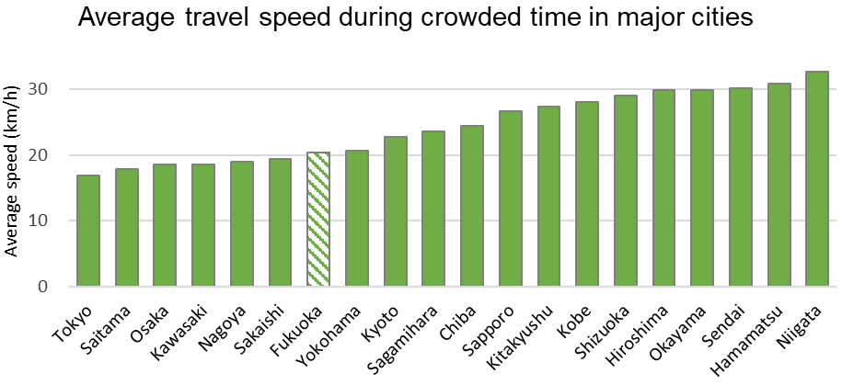
3.1
Introduction
Background
Problems
1
2
3
Reduction in share rate of public transit
Aging population
Traffic congestion
Chapter 3 - Analysis on the characteristics of transit ridership and land use

Slide 118
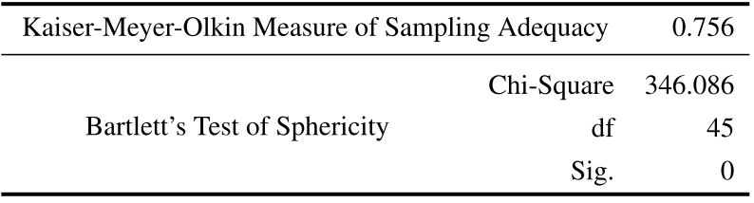
3.3
Characteristics of transit ridership and land use
Land use characteristics
Factor analysis
Purpose
To deal with the strong collinearity among indicators
Further explore the internal relationship
Test for factor analysis
Suggested value
> 0.7
KMO and Bartlett’s Test
Suggested value
< 0.05
PASSED the test
Chapter 3 - Analysis on the characteristics of transit ridership and land use
Notes:
To deal with this linear correlation, the factor analysis is conducted to make a further exploration on the internal relationship.
According to the test for factor analysis, this dataset is thought to be suitable to do factor analysis.

Slide 119
3.1
Introduction
Background
Problems
1
2
3
Reduction in share rate of public transit
Aging population
Traffic congestion
Demands
Promoting the use of rail transit
Alleviating the pressure on government finances
Chapter 3 - Analysis on the characteristics of transit ridership and land use

Slide 120
3.3
Characteristics of transit ridership and land use
Land use characteristics
Station classification based on land use
Type | Station No. | Population-density | Office | Commerce | Residence | Education
Low-density residence | 30 | 33 | 1.70% | 41.50% | 44.95% | 0.18%
 | 26 | 54 | 2.81% | 1.23% | 58.26% | 2.85%
 | 29 | 78 | 3.02% | 5.40% | 75.86% | 6.94%
 | 27 | 79 | 4.30% | 4.24% | 75.87% | 0.77%
 | 28 | 81 | 3.55% | 3.42% | 73.46% | 6.24%
 | 3 | 91 | 4.01% | 8.58% | 59.97% | 6.25%
 | 33 | 101 | 1.74% | 2.10% | 81.71% | 7.84%
 | 24 | 103 | 2.14% | 2.17% | 66.82% | 8.30%
 | 34 | 109 | 2.38% | 3.28% | 86.12% | 0.86%
Low-density residence
Low population-density
High proportion of residence
Chapter 3 - Analysis on the characteristics of transit ridership and land use
Notes:
According to the analysis of land use indicators, all the 35 stations are classified into several types.
The first is low-density residence, with Low population-density, and High proportion of residence

Slide 121
3.3
Characteristics of transit ridership and land use
Land use characteristics
Station classification based on land use
Type | Station No. | Population-density | Business | Commerce | Residence | Education
High-density residence | 19 | 121 | 2.17% | 3.15% | 76.63% | 0.12%
 | 13 | 125 | 11.11% | 6.48% | 46.08% | 4.51%
 | 16 | 142 | 4.59% | 5.03% | 72.75% | 2.68%
 | 18 | 142 | 2.27% | 1.96% | 64.58% | 6.80%
 | 31 | 143 | 4.14% | 2.26% | 54.17% | 18.28%
 | 17 | 144 | 6.02% | 7.28% | 55.45% | 10.60%
 | 12 | 145 | 4.16% | 1.77% | 66.22% | 4.39%
 | 32 | 170 | 1.17% | 1.28% | 73.54% | 9.93%
 | 23 | 193 | 10.00% | 6.18% | 44.52% | 2.56%
High-density residence
High population density
High proportion of residence
Chapter 3 - Analysis on the characteristics of transit ridership and land use
Notes:
The second is high-density residence, with high population-density, and High proportion of residence

Slide 122
3.3
Characteristics of transit ridership and land use
Land use characteristics
Station classification based on land use
Type | Station | Population-density | Business | Commerce | Residence | Education
Education | 25 | 35 | 1.38% | 2.31% | 30.04% | 39.83%
 | 1 | 56 | 8.70% | 1.91% | 48.01% | 17.89%
 | 35 | 58 | 5.63% | 3.78% | 55.18% | 21.37%
 | 4 | 67 | 4.93% | 3.49% | 33.52% | 14.63%
 | 2 | 77 | 4.03% | 11.75% | 44.03% | 23.24%
 | 5 | 89 | 11.53% | 7.26% | 30.51% | 7.30%
Education
High proportion of education
Chapter 3 - Analysis on the characteristics of transit ridership and land use
Notes:
The third is education, with high proportion education

Slide 123
3.3
Characteristics of transit ridership and land use
Land use characteristics
Station classification based on land use
Type | Station | Population-density | Business | Commerce | Residence | Education
Downtown commerce | 9 | 64 | 44.97% | 20.55% | 10.62% | 0.70%
 | 20 | 67 | 34.60% | 36.74% | 11.34% | 1.26%
 | 8 | 67 | 42.97% | 27.86% | 12.23% | 0.59%
 | 11 | 79 | 37.12% | 17.38% | 18.47% | 1.89%
 | 10 | 92 | 30.76% | 26.26% | 15.72% | 1.74%
Downtown commerce
High proportion of business
High proportion of commerce
Chapter 3 - Analysis on the characteristics of transit ridership and land use
Notes:
Then is downtown commerce, with high proportion in both business and commerce.

Slide 124
3.3
Characteristics of transit ridership and land use
Land use characteristics
Station classification based on land use
Type | Station | Population-density | Business | Commerce | Residence | Education
Office | 15 | 64 | 31.63% | 7.80% | 25.80% | 5.73%
 | 6 | 96 | 34.56% | 17.29% | 21.61% | 1.75%
 | 14 | 105 | 26.97% | 17.27% | 17.61% | 2.80%
 | 21 | 136 | 22.86% | 16.12% | 33.66% | 2.70%
 | 22 | 167 | 21.38% | 12.53% | 36.79% | 2.50%
Office
High proportion of business
Chapter 3 - Analysis on the characteristics of transit ridership and land use
Notes:
Next is the office type, with high proportion in business.

Slide 125
4.1
Introduction
Purpose
Explore and explain the factors influencing subway ridership at station level using a small sample case
Research questions
1
Improve index system
Propose and reconstruct indicators to improve the index system
2
Identify valid indicators
Propose effective index screening method for small samples
3
Improve accuracy in estimation
Consider the different spatial distribution of indicators in the spatial regression model
Chapter 4 - Influencing Factors on Transit Ridership at Station Level
Notes:
The main purpose of chapter 4 is to explore and explain the factors influencing subway ridership at station level using a small sample case.
Around this purpose, this study focuses on three specific topics.
The first one is to propose and reconstruct indicators to improve the index system
Second is to find an approach of identifying the valid indicators for small sample case.
The third one is to consider the different spatial distribution of indicators in the spatial regression model to improve accuracy in estimation.

Slide 126

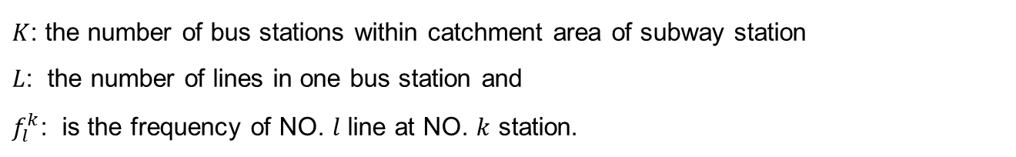

4.2
Indicators
Variable interpretation
Bus capacity
$$BC=\sum_{k}^{K}{\sum_{l}^{L}{f_{l}^{k}}}$$
$K$: the number of bus stations within catchment area of subway station
$L$: the number of lines in one bus station and
$f_{l}^{k}$: is the frequency of NO. $l$ line at NO. $k$ station.
Bus Accessibility
$$BA =\sum_{k}^{K}{R_{k}}$$
$R_{k}$: is the number of bus lines passing through the $k$th bus station.
Chapter 4 - Influencing Factors on Transit Ridership at Station Level
Notes:
There are the two indicators about bus system. In this study, I considered the effect of bus system from two opposite parts, one is the bus capacity, and the other one is bus accessibility.
The indicator of bus capacity represents the ability of how many passengers the bus system can transfer, it relates to the number of bus stops, bus lines and the frequency of bus within the catchment area. It is expected to have negative effect on rail transit ridership, since the large bus capacity may share parts of the passengers from rail transit.
The indicator of bus accessibility represents the areas connecting to the bus system within the catchment area. It only relates to the number of bus lines. This indicator is expected to have positive effect on rail transit ridership, since a better accessibility of bus may take more rail transit passengers.

Slide 127
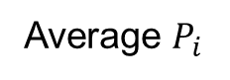

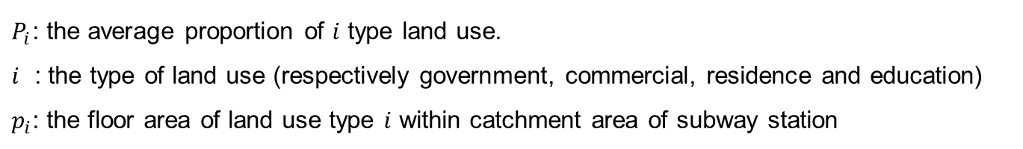
4.2
Indicators
Variable interpretation
Land-use Aggregation
The indicator of land-use mix is re-defined into the aggregation of land-use.
$A=\sqrt{\sum{{\left(p_{i}−P_{i}\right)}^{2}}}$
$P_{i}$: the average proportion of $i$ type land use.
$i$ : the type of land use (respectively government, commercial, residence and education)
$p_{i}$: the floor area of land use type $i$ within catchment area of subway station
Range of PCA | Residence | Office | Commerce | Education | Total
600 | 51.8% | 19.3% | 13.8% | 5.5% | 90.5%
800 | 55.3% | 17.5% | 12.0% | 6.2% | 90.9%
1000 | 57.6% | 16.5% | 10.8% | 6.0% | 90.9%
1200 | 59.2% | 15.5% | 10.2% | 5.9% | 90.8%
Ave | 62.8% | 10.1% | 7.5% | 5.3% | 85.7%
Average $P_{i}$
Chapter 4 - Influencing Factors on Transit Ridership at Station Level
Notes:
Let me go on to interpret some of the indicators. Firstly, the variable of land-use aggregation. This indicator is used to describe the variety of land use. Maybe we usually hear about the word of land-use mix, but not aggregation. Here I redefined it. Look at this formula, it represents the spatial distance between the uppercase P and lowercase p, where the uppercase P means the average proportion of each kind of land use, and the lowercase p represents the proportion in the observing station. The higher the indicator A is, the function of land use is more aggregative, which means the land use variety is lower. The reference value of uppercase P is calculated from the average of all the stations in Fukuoka, using the catchment area of 800 meters walking distance.

Slide 128






4.2
Indicators
Variable interpretation
Indicators of bus system
Bring passengers to rail transit
Departure
Destination
Departure
Share passengers from rail transit
Bus capacity
Share passengers from rail transit. Negative effect on rail transit ridership
Bus Accessibility
Bring passengers to rail transit. Positive effect on rail transit ridership
Chapter 4 - Influencing Factors on Transit Ridership at Station Level
Notes:
In this study, the indicator of bus system is considered from two aspects.
Like shown in the figure, bus should have two effect on the rail transit, one is bringing passengers to rail transit, and another one is share passengers from rail transit.
The indicator of bus capacity is expected to share passengers from rail transit, having negative effect on rail transit.
The indicator of bus accessibility is expected to bring passengers to rail transit, having positive effect on rail transit.

Slide 129
4.4
Model estimation
Identification for global/local variable
Variable | Moran's Index | Z-score | P-value* | Pattern | DIFF of Criterion** | Type
Government Area | 0.04 | 0.66 | 0.51 | Random | - | Global
Transportation Facility | 0.29 | 3.33 | 0.00 | Clustered | -1.95 | Local
Land use Aggregation | -0.01 | 0.20 | 0.84 | Random | - | Global
Transfer Dummy | 0.13 | 1.58 | 0.12 | Random | - | Global
Bicycle Parking | -0.12 | -0.92 | 0.36 | Random | - | Global
Bus Capacity | 0.70 | 7.57 | 0.00 | Clustered | 0.18 | Local
Bus Accessibility | 0.45 | 5.04 | 0.00 | Clustered | 0.04 | Local
Population/Job Balance | 0.77 | 7.61 | 0.00 | Clustered | -0.17 | Local
Tenant Proportion | 0.24 | 2.54 | 0.01 | Clustered | 1.02 | Local
* Statistical significance means autocorrelation
** More than or equal to 2.00, means the local term is better to be assumed as global
Chapter 4 - Influencing Factors on Transit Ridership at Station Level
Notes:
Before estimating the model, we should determine whether the indicator is a local or global indicator.
This procedure is conducted by using Moran’s index to examine if the variable is spatial autocorrelation or not.
The indicators with clustered pattern are selected as the local variable.

Slide 130
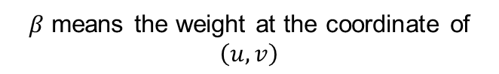
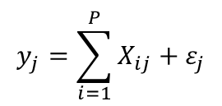
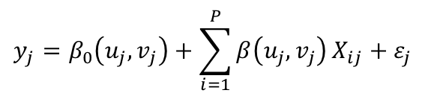
4.4
Model estimation
Ordinary regression
MGRW parameter
Kernel Type
$$y_{j}=\sum_{i=1}^{P}{X_{ij}}+ε_{j}$$
Fixed Gaussian kernel function
Bandwidth selection method
Golden-section search
MGRW model
$$y_{j}=β_{0}\left(u_{j},v_{j}\right)+\sum_{i=1}^{P}{β\left(u_{j},v_{j}\right)}X_{ij}+ε_{j}$$
5.7km
$β$ means the weight at the coordinate of $\left(u,v\right)$
Chapter 4 - Influencing Factors on Transit Ridership at Station Level
Notes:
With these screened indicators, I’m going to estimate the influence on transit ridership quantitively. The transit ridership is not like the common sampling data, it also depends on spatial distribution. Therefore the mix geographically weighted regression is used to deal with the spatial relationship. As we can see the difference between the two formula, beta means the weight at the coordinate of (u, v). The two important parameters in MGRW is set as shown. The bandwidth is set to 5.7 kilometers, which is selected by golden-section search.

Slide 131
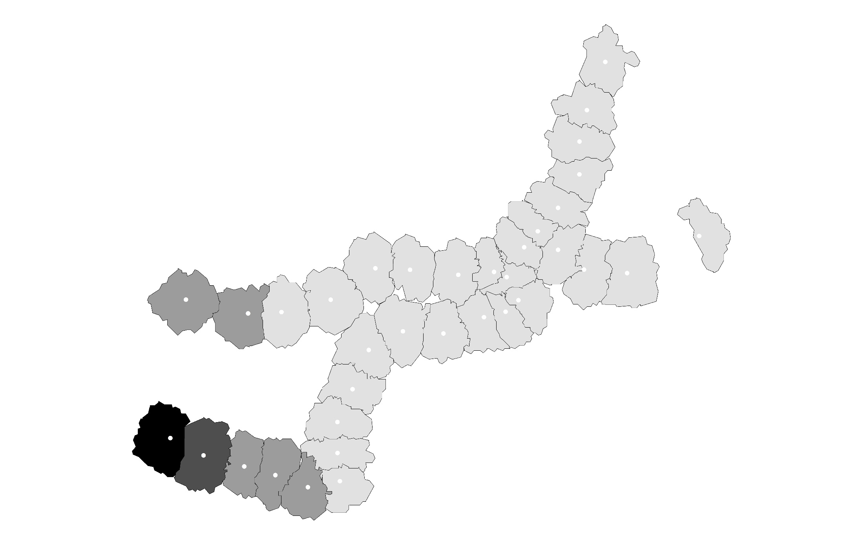
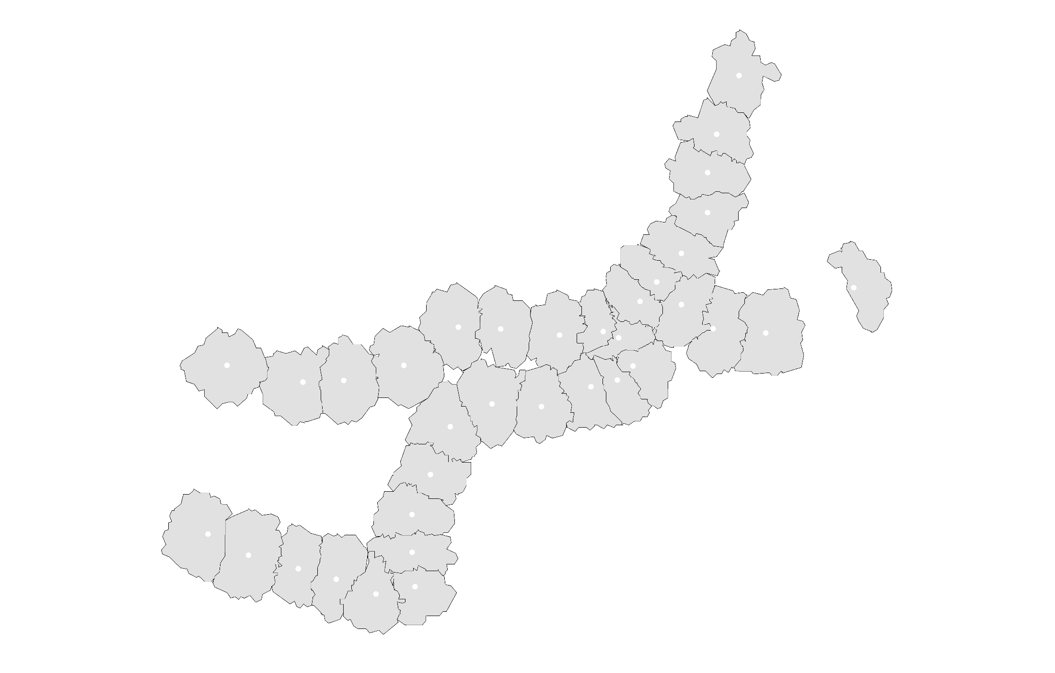
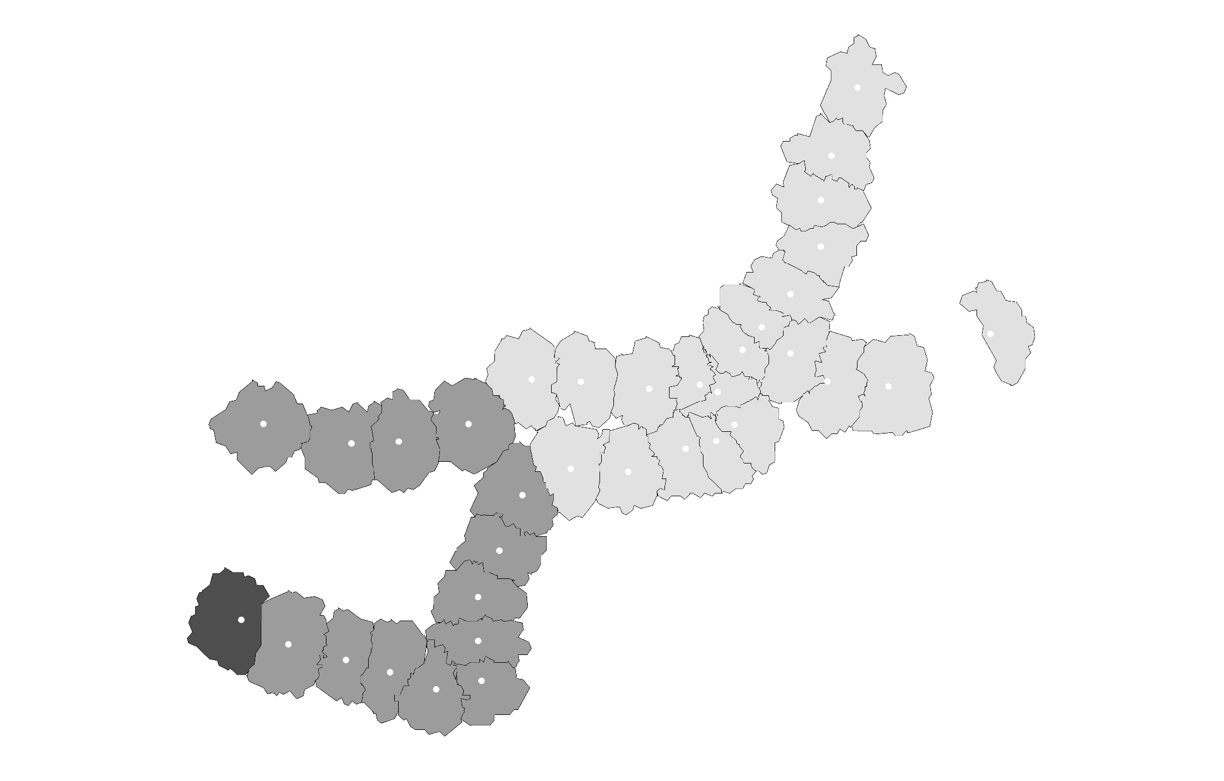


4.5
Residual Analysis
Significance Map
Transportation Facility Area
Bus Accessibility
Bus Capacity
Significance Map
P = 0.01
P = 0.05
P = 0.1
Not Significance
Population Job Balance
Tenant Proportion
Chapter 4 - Influencing Factors on Transit Ridership at Station Level
Notes:
The spatial distribution of significance for each local variable are mapped in Figure 4.4. For the variables of building area of transportation, bus capacity, bus accessibility, job-resident balance and tenant proportion, there are 33, 34, 35, 24 and 32 data points having statistical significance at confidence level 95% respectively. As in the figures, the two indicators for bus that proposed in this study have good performance in terms of significance and stability, while the variable of ‘tenant proportion’ has a little worse stability.

Slide 132
4.4
Model estimation
Estimation of Mix Geographically Weighted Regression
Variable | Type | OLS model |  |  |  | MGWR model
 |  | B | SE | t |  | B | SE | t
Government Area | Global | 0.05 | 0.02 | 2.41 |  | 0.05 | 0.02 | 2.59
Land Use Aggregation | Global | 11,832.53 | 5323.15 | 2.22 |  | 13,384.34 | 5,408.81 | 2.48
Transfer Dummy | Global | 6,578.09 | 1216.82 | 5.41 |  | 5,968.65 | 1,198.72 | 4.98
Bicycle Parking | Global | 7.51 | 0.93 | 8.11 |  | 7.72 | 0.90 | 8.59
Transport Area | Local | 0.11 | 0.03 | 3.58 |  | 0.10 | 0.02 | -
Bus Capacity | Local | -59.21 | 20.71 | -2.86 |  | -55.14 | 5.94 | -
Bus Accessibility | Local | 50.71 | 14.64 | 3.46 |  | 48.61 | 2.43 | -
Population/Job Balance | Local | -2,762.24 | 1,079.33 | -2.56 |  | -2,411.17 | 364.44 | -
Tenant Proportion | Local | -9,987.81 | 4,380.30 | -2.28 |  | -10,304.66 | 756.09 | -
Best bandwidth |  |  |  |  |  | 5.7km
AICc |  | 694.39 |  |  |  | 690.60
Residual sum of squares |  | 337,744,989 |  |  |  | 296,311,499
Chapter 4 - Influencing Factors on Transit Ridership at Station Level
Notes:
This is the result of estimation.
As a result, the indicators of building area have a positive effect on the subway ridership.
The indicator of land-use aggregation shows land use variety can lead to decrease in ridership.
As the expectation, the indicator of bus capacity has a negative effect on the subway ridership, and the bus accessibility has a positive effect.
The factor of resident/job balance and tenant proportion tells that working people and tenants are more willing to use subway.

Slide 133
4.5
Model estimation
Distribution of residuals
Indicator | OLS | MGWR
Moran’s index | 0.08 | 0.03
Expected index | -0.03 | -0.03
Variance | 0.01 | 0.01
z-score | 1.09 | 0.61
p-value | 0.27 | 0.54
Closer to the expected value is better
Less is better
Moran’s index in MGWR is closer to the expected index than that in OLS
Z-score in MGWR is lower than that in OLS
Chapter 4 - Influencing Factors on Transit Ridership at Station Level
Notes:
This part is the residual analysis.
From the residual distribution, Moran’s index in MGWR is closer to the expected index than that in OLS, Z-score is also lower than that in OLS.
We can say the result of MGWR is better than that of OLS.
The lower part is the distribution of residuals of both linear regression and geographically weighted regression, to have a look if the accuracy increased. The Moran’s index in MGWR is closer to the expected index than that in OLS, and the Z-score in MGWR is less than that in OLS, the accuracy did increase.

Slide 134
4.6
Conclusion
Main works
Reclassified and reorganized the indicator framework.
Proposed the approach of selecting variables from candidates using the tool of exploratory regression in ArcGIS.
Provided a method for judging whether a variable is global or local used in estimating the MGWR model.
Main findings
The higher diversity of land use leads to decrease in transit ridership.
The bus system has both positive and negative effects on rail transit ridership.
The tenants are more willing to use rail transit in the case of Fukuoka.
Chapter 4 - Influencing Factors on Transit Ridership at Station Level
Notes:
For a conclusion, this study reorganized the indicator framework, and proposed a method for selecting valid variables. Also, provided a way for judging whether a variable is global or local in the mix geographically weighted regression model.
Also there are some interesting finding from this study.
The higher diversity of land use leads to decrease in transit ridership.
The bus system has both positive and negative effects on rail transit ridership.
The tenants are more willing to use rail transit in the case of Fukuoka.

Slide 135
5.1
Introduction
Background
Station level
Station-to-station level
Chapter 5 - Influencing Factors on Transit Ridership at Station-to-Station Level
Notes:
At the beginning, I want to repeat it once again that why I focus on the ridership between station and station.
There is a station A, if the ridership of station A varied because of the variation in the elements within the catchment area of station A, it is obvious, the transit ridership of station B will also vary, because station A is connecting with station B, the variation of transit ridership in Station A must bring new variation in Station B.
With this issues, the purpose of this study is proposed, Exploring how the factors of land-use influence the choice of destination station for passengers from the perspective of TOD

Slide 136
5.1
Introduction
Description for the research
Differences with station-level
 | Scale | Objective
Station-Level | single station | OD pair of stations
Station-to-Station-Level | station network | OD transit ridership
Research contents
To describe the connectivity between different stations using OD ridership.
To explain how the connectivity is determined by land-use factors.
Chapter 5 - Influencing Factors on Transit Ridership at Station-to-Station Level
Notes:
This study is at the station-to-station level, but not station-level. Different from station-level, the research scale shift to station network but not a sing station, the research objective is changed to OD passenger volume but not the passenger volume of single station. The emphasis of station-to-station level is not only the prediction of ridership, but also the connectivity between the station and station.
The research contents mainly have two parts, to describe the connectivity between different stations using OD ridership, and to explain how the connectivity is determined by land-use factors.

Slide 137
5.1
Introduction
Research contents
Problems in previous studies
Key points
Problem 1
1
Describe the transit ridership transfer between station and station
The transit ridership is generated at the origin station, and then transferred to the destination station. But few studies focused on the procedure of passenger transfer between the departure and destination stations.
Using the probability of choosing a specific destination station to describe the transit ridership between station and station.
Chapter 5 - Influencing Factors on Transit Ridership at Station-to-Station Level
Notes:
According to the review, some problems not well addressed are summarized. Based on which, the key points of this study are proposed. The first one is to find an indicator to describe the passenger transfer between station and station.

Slide 138
5.1
Introduction
Research contents
Problems in previous studies
Key points
2
Find a proper function to estimate the influencing factors of the passenger transfer of ridership between stations and stations
Problem 2
In terms of the methods, the linear regression is not proper to describe and estimate the passenger transfer between stations and stations
Convert this issue into the mathematical problem, then estimate the effect of influencing factors.
Chapter 5 - Influencing Factors on Transit Ridership at Station-to-Station Level
Notes:
The second key point is about the method. Because the linear regression is not proper to describe and estimate the passenger transfer between stations and stations, this study will try to find a proper method to estimate the influencing factors of the passenger transfer of ridership between stations and stations

Slide 139
5.1
Introduction
Review
Previous study |  | Type 1 | Type 2 | Type 3 | This
Perspective | Station | ●
 | Station-to-station |  | ● | ● | ●
Research object | Dependent variable | Transit ridership | Transit ridership | Transportation Impedance | Destination selection probability
 | Explanatory variable | Single station | Origin and destination stations | Origin and destination stations | Origin and destination stations
Method | Linear Regression | ● | ●
 | Gravity model |  |  | ●
 | Logistic regression |  |  |  | ●
Chapter 5 - Influencing Factors on Transit Ridership at Station-to-Station Level
Notes:
Before the analysis, I want to give a brief review of previous studies to show how this study differs from the others.
This study focused on the relationship between station and station. For the research object, not like the other studies using transit ridership as b

Slide 140
5.1
Introduction
Flowchart
Index framework
Dependent variable
Independent variable
Conversion of realistic issue
Probability of getting off at a specific destination station
Discrete choice issue
Logistic regression
Model estimation
Result and Discussion
Chapter 5 - Influencing Factors on Transit Ridership at Station-to-Station Level
Notes:
This is the research flow of this study.
First, I will construct the index framework, and then convert this realistic issue into a mathematical problem.
Finally, estimate the logistic regression model, and give discussion for the result.

Slide 141
5.3
Method
Description for the research question
Boarding
Alighting
Station 1
Other
Stations
……
Station 2
Station k
……
Dependent variable
Independent variable
land-use feature of boarding station
Impedance between boarding and alighting station
Affect
Choice of whether to get off at station k
Chapter 5 - Influencing Factors on Transit Ridership at Station-to-Station Level
Notes:
Before constructing the mathematical model, I am going to explain how to convert this realistic problem into a mathematical problem. If we examine the case of alighting station k, this probability of getting off at station k is affected by the land-use and impedance of boarding station. Here we can convert this problem into a discrete choice problem. And it can be expressed using logistic regression. In this logistic regression, if we take the alighting station k as an example, the dependent variable is the connectivity between all the boarding stations and alighting station k, it is the probability of getting off at station k. The independent variables are the land-use of departure stations and the impedance between boarding stations and the alighting station k.

Slide 142
5.3
Method
Selecting sample station
Station type | Station name | Population density | Commerce proportion | Office proportion | Residence proportion | Education proportion
Low-density residence | 賀茂 | 98 Person/Ha | 4% | 3% | 83% | 4%
High-density residence | 藤崎 | 173 Person/Ha | 5% | 7% | 76% | 6%
Education | 箱崎九大前 | 83 Person/Ha | 5% | 6% | 51% | 22%
Office | 呉服町 | 135 Person/Ha | 8% | 31% | 49% | 3%
Commerce | 天神 | 69 Person/Ha | 34% | 32% | 24% | 1%
Note:
The highlighted cells refer to the representative values that having much higher proportion than other land-use types.
Chapter 5 - Influencing Factors on Transit Ridership at Station-to-Station Level
Notes:
In this problem, what we want to know is how the independent variables determine the choice of where to get off.
To master the significant features of choosing destination regarding different type of land-use, I will select some typical stations as research objective.
I chose one station from each of the land use type.
The six stations are Kamo station of medium-density residence
Fujisaki station of high-density residence
Hakozakikyudai station of education
Gofukumachi station of office
Tenjin station of commerce
and airport station.

Slide 143
5.4
Results and discussion
Result of estimation
Destination Station |  | Variables in Departure Station
Station Type | Station Name | Land-use |  |  |  |  |  | Impedance
 |  | C | O | R | E | L-A |  | D | B-C | B-A
Low-density residence | 賀茂 | 0.95 | 0.94 | 0.94 | 0.93 | 0.97 |  | 1.07 | 1.01 | 1.00
High-density residence | 藤崎 | 1.01 |  | 0.99 | 1.01 | 0.98 |  | 0.95 | 1.00 | 1.00
Education | 箱崎九大前 | 1.02 |  | 1.02 | 1.03 | 0.99 |  | 0.88 | 0.00 | 0.00
Office | 呉服町 | 1.02 | 0.98 | 1.02 | 1.06 | 0.99 |  |  | 1.00 | 1.00
Commerce | 天神 | 1.00 | 0.99 | 1.01 | 1.03 | 1.02 |  | 1.06 |  | 1.00
Airport | 空港 | 0.97 | 1.03 | 0.99 | 0.99 | 1.03 |  | 0.92 | 1.00 | 1.00
Increase in this type of land use will lead to a decrease in the probability of choosing this station as the destination
Increase in this type of land use will lead to an increase in the probability of choosing this station as the destination
Meaning of the coefficients
1% increase in the proportion of land use will lead to a corresponding variation in the probability of getting off at the destination
Note
Full name of the abbreviation
C: Commerce
O: Office
R: Residence
E: Education
L-A: Land-use Aggregation
D: Distance
B-C: Bus Capacity
B-A: Bus Accessibility
Chapter 5 - Influencing Factors on Transit Ridership at Station-to-Station Level
Notes:
This is the result of estimation.
In this table, the values less than 1 means Increase in this type of land use will lead to a decrease in the probability of choosing this station as the destination
The values larger than 1 means Increase in this type of land use will lead to an increase in the probability of choosing this station as the destination
For the meaning of the coefficients, 1% increase in the proportion of land use will lead to a corresponding variation in the probability of getting off at the destination
. The blank means this value does not pass the statistical significance test.

Slide 144
5.4
Results and discussion
Discussion for results
Gray areas represent negative effects
Commerce
Office
All in the gray area
Land use aggregation
Education
Residence
All in the white area
Chapter 5 - Influencing Factors on Transit Ridership at Station-to-Station Level
Notes:
Then I will give some details for the results.
Look at the values marked with frame.
It means the any type of Land use increased in departure station
The Probability of choosing the destination station belong to low-density residence type will decrease

Slide 145
5.5
Conclusion
Main works
Defined the “connectivity” between station and station
The influence of land use on the connectivity was estimated
In the future
The indicator system should be further enriched
The share of different transportation modes should be considered
The indicators belong to impedance should be improved
The influence of bus system also should be considered at the station-to-station level
Chapter 5 - Influencing Factors on Transit Ridership at Station-to-Station Level
Notes:
This is the chapter 5, the main work of this study includes two parts, Defined the “connectivity” between station and station. The influence of land use on the connectivity was estimated.
Also we got some implications for the future, Further enrich the indicator system. The share of different transportation modes should be considered. The indicators belong to impedance should be improved. The influence of bus system also should be considered at the station-to-station level

Slide 146
6.2
Contributions
Chapter 2
Reinterpreted the implication of surveyed walking distance/duration to transit stations. The surveyed walking distance/duration has no linear relation with people willingness but just the reﬂection of the distance between departures and stations.
Described the correlation between surveyed walking duration and people’s individual characteristics from the view of probability, which can be further applied to the estimation of catchment area of rail transit stations.
Chapter 6 - Conclusion

Slide 147
6.2
Contributions
Chapter 3
Analyzed the trend of variations in transit ridership, and classiﬁed the sub-way stations of Fukuoka into 5 types in terms of land use. Conﬁrmed the correlations between transit ridership and land use.
Chapter 6 - Conclusion

Slide 148
6.2
Contributions
Chapter 4
Considered the inﬂuence of bus on rail transit ridership from both the sides of bus capacity and bus accessibility, and veriﬁed that the effect of bus capacity is positive to rail transit ridership, while the effect of bus accessibility is negative.
Proposed the approach of screening valid indicators by introducing the exploratory regression, and conﬁrmed its effectiveness in a small sample case.
Distinguished the local and global variables in MGWR model by examining the spatial distribution of each variable, and the effectiveness was conﬁrmed in the estimation of MGWR model
Chapter 6 - Conclusion

Slide 149
6.2
Contributions
Chapter 5
By examining the probability of selecting the destination station from all the stations, established a logistic regression model for describing the correlation between stations and stations.
Quantitatively validated the impact of land use types on the selection of destination stations.
Chapter 6 - Conclusion

Slide 150
6.1
Summary
Main findings
Analyzed the inﬂuence of various factors on rail transit ridership from station level and station-to-station level respectively.
Provided new explanations for the catchment area of rail transit stations.
Provided an approach for selecting the valid indicators
Proposed a ridership forecasting method with the consideration of interaction among stations and stations
Chapter 6 - Conclusion

Slide 151
6.2
Recommendations
How to increase the use of rail transit
People’s walking preferences have signiﬁcant inﬂuence on the use of rail transit. It is suggested that the design for pedestrian accessibility should also consider the individual characteristics of resident, thus helping increase the use of rail transit.
With the development of rail transit, if viewing from the whole transit system, the positioning of bus system is gradually inclining to be the connection between departures and rail transit. Rather than planning higher capacity for bus transport, it is suggested to plan more accessible bus routes which can help people use rail transit more convenient.
According to the ﬁndings, the more aggregation in land use functions the more demand in rail transit. Thus suggesting to connect more functional regions as possible when making rail transit planning.
Chapter 6 - Conclusion

Slide 152
6.2
Recommendations
The further research
Enrich indicator system
Combine the estimation of catchment area and the prediction of transit ridership.
Explore how the rail transit affect land use.
Explore the balance condition among various elements in the catchment area of transit stations, including human, resource, land use, transportation etc., providing reference to create the compact city.
Chapter 6 - Conclusion

Slide 153
Chapter 1
Introduction
Background
Research purpose
Research contents
Primary research questions
Notes:
The chapter 1 is a brief introduction for the whole dissertation

Slide 154
Chapter 2
Analyzing Willingness of Walking Duration to Transit Stations Using Socio-Demographic Characteristics
Introduction
Methods
Data description
Selection for Valid Features
Estimation of Features
Result and Discussion
Conclusion
Notes:
The chapter 2, Analyzing Willingness of Walking Duration to Transit Stations Using passenger’s personal attributes

Slide 155
Chapter 3
Analysis on the characteristics of transit ridership and land use
Introduction
Data
Characteristics of transit ridership and land use
Exploration the influence on transit ridership
Conclusion
Notes:
Next, Chapter 3, Analysis on the characteristics of transit ridership and land use.

Slide 156
Chapter 4
Influencing Factors on Transit Ridership at Station Level
Introduction
Indicators
Identification of valid factors
Model estimation
Residual analysis
Conclusion
Notes:
Next, chapter 4, Influencing Factors on Transit Ridership at Station Level.

Slide 157
Chapter 5
Influencing Factors on Transit Ridership at Station-to-Station Level
Introduction
Research object
Method
Results and Discussion
Conclusion
Notes:
Chapter 5, Influencing Factors on Transit Ridership at Station-to-Station Level

Slide 158
Chapter 6
Conclusion
Findings
Recommendations

Slide 159
2.1
Introduction
The question to answer
1
What influence the walking duration to transit stations?
Walking duration
1
Station
Station
Ridership
Ridership
2
3
2
What factors explain transit ridership at station level?
3
What factors influence transit ridership between station and station?
Chapter 2 - Analyzing Willingness of Walking Duration to Transit Stations Using Socio-Demographic Characteristics
Notes:
This study aims to answer the first primary question that I proposed at the very beginning.
That is, what influence the walking duration to transit stations.

Slide 160
4.1
Introduction
The question to answer
1
What influence the walking duration to transit stations?
Walking duration
1
Station
Station
Ridership
Ridership
2
3
2
What factors explain transit ridership at station level?
3
What factors influence transit ridership between station and station?
Chapter 4 - Influencing Factors on Transit Ridership at Station Level
Notes:
Chapter 4 aims to answer the second question that I proposed at the very beginning
it is What factors explain transit ridership at station level?

Slide 161
5.1
Introduction
The question to answer
1
What influence the walking duration to transit stations?
Walking duration
1
Station
Station
Ridership
Ridership
2
3
2
What factors explain transit ridership at station level?
3
What factors influence transit ridership between station and station?
Chapter 5 - Influencing Factors on Transit Ridership at Station-to-Station Level
Notes:
This chapter aims to answer the third question that I proposed at the very beginning, that is What factors influence transit ridership between station and station?

Slide 162
5.4
Results and discussion
Discussion for results
Destination Station |  | Variables in Departure Station
Station Type | Station Name | Land-use |  |  |  |  |  | Impedance
 |  | C | O | R | E | L-A |  | D | B-C | B-A
Low-density residence | 賀茂 | 0.95 | 0.94 | 0.94 | 0.93 | 0.97 |  | 1.07 | 1.01 | 1.00
High-density residence | 藤崎 | 1.01 |  | 0.99 | 1.01 | 0.98 |  | 0.95 | 1.00 | 1.00
Education | 箱崎九大前 | 1.02 |  | 1.02 | 1.03 | 0.99 |  | -0.13 | 0.00 | 0.00
Office | 呉服町 | 1.02 | 0.98 | 1.02 | 1.06 | 0.99 |  |  | 1.00 | 1.00
Commerce | 天神 | 1.00 | 0.99 | 1.01 | 1.03 | 1.02 |  | 1.06 |  | 1.00
Airport | 空港 | 0.97 | 1.03 | 0.99 | 0.99 | 1.03 |  | 0.92 | 1.00 | 1.00
画成雷达图
Result
Land use increased in departure station: All types
Probability of choosing the destination station belong to low-density residence type: decrease
Chapter 5 - Influencing Factors on Transit Ridership at Station-to-Station Level
Notes:
Then I will give some details for the results.
Look at the values marked with frame.
It means the any type of Land use increased in departure station
The Probability of choosing the destination station belong to low-density residence type will decrease

Slide 163
5.4
Results and discussion
Discussion for results
Destination Station |  | Variables in Departure Station
Station Type | Station Name | Land-use |  |  |  |  |  | Impedance
 |  | C | O | R | E | L-A |  | D | B-C | B-A
Low-density residence | 賀茂 | 0.95 | 0.94 | 0.94 | 0.93 | 0.97 |  | 1.07 | 1.01 | 1.00
High-density residence | 藤崎 | 1.01 |  | 0.99 | 1.01 | 0.98 |  | 0.95 | 1.00 | 1.00
Education | 箱崎九大前 | 1.02 |  | 1.02 | 1.03 | 0.99 |  | -0.13 | 0.00 | 0.00
Office | 呉服町 | 1.02 | 0.98 | 1.02 | 1.06 | 0.99 |  |  | 1.00 | 1.00
Commerce | 天神 | 1.00 | 0.99 | 1.01 | 1.03 | 1.02 |  | 1.06 |  | 1.00
Airport | 空港 | 0.97 | 1.03 | 0.99 | 0.99 | 1.03 |  | 0.92 | 1.00 | 1.00
Result
Land use increased in departure station: increase in education
Probability of choosing the destination station: increase
Chapter 5 - Influencing Factors on Transit Ridership at Station-to-Station Level
Notes:
Look at the column of education
It means the Increase in the education land use tends to lead increase in the ridership between station and station.

Slide 164
5.4
Results and discussion
Discussion for results
Destination Station |  | Variables in Departure Station
Station Type | Station Name | Land-use |  |  |  |  |  | Impedance
 |  | C | O | R | E | L-A |  | D | B-C | B-A
Low-density residence | 賀茂 | 0.95 | 0.94 | 0.94 | 0.93 | 0.97 |  | 1.07 | 1.01 | 1.00
High-density residence | 藤崎 | 1.01 |  | 0.99 | 1.01 | 0.98 |  | 0.95 | 1.00 | 1.00
Education | 箱崎九大前 | 1.02 |  | 1.02 | 1.03 | 0.99 |  | -0.13 | 0.00 | 0.00
Office | 呉服町 | 1.02 | 0.98 | 1.02 | 1.06 | 0.99 |  |  | 1.00 | 1.00
Commerce | 天神 | 1.00 | 0.99 | 1.01 | 1.03 | 1.02 |  | 1.06 |  | 1.00
Airport | 空港 | 0.97 | 1.03 | 0.99 | 0.99 | 1.03 |  | 0.92 | 1.00 | 1.00
Result
Land use increased in departure station: The same type with the that of the destination station
Probability of choosing the destination station: decrease
Chapter 5 - Influencing Factors on Transit Ridership at Station-to-Station Level
Notes:
Look at the values with frames.
This represent, the probability of choosing a destination has a trend of decreasing between the same type of land use.

Slide 165
6.1
Conclusion
Walking duration
5 minutes is a widely accepted walking duration to rail transit.
Whether accepting the 8 minutes walking duration is ambiguous in passenger’s practical behaviors.
Passengers with the private travel purpose tend to accept the longest walking duration.
Passengers with the commuting travel purpose and during the peak hour tend to arrive at transit station as soon as possible.
Chapter 6 - Conclusion

Slide 166
6.1
Findings
Valid factors selection in small sample case
Approach of screening valid indicator in small sample case is confirmed to be effective.
High diversity of land use leads to decrease in transit ridership.
The bus system has both positive and negative effects on rail transit ridership.
The tenants are more willing to use rail transit in the case of Fukuoka.
Chapter 6 - Conclusion

Slide 167
6.1
Findings
Choice of destination regarding land use
Confirmed the influence of land use on the choice of destination.
The probability of choosing a destination has a trend of decreasing between the same type of land use.
The probability of choosing a destination belong to low-density residence type never increase regarding to the variation of land use in the departure station.
Increase in the education land use tends to lead increase in the ridership between station and station.
Chapter 6 - Conclusion

